Slide 1
Notes:
073120

Slide 2
Module 4
Non-infectious and infectious skin disorders
Acne Types
Notes:
How this class works:
This class has been designed in modules, including extra slides.
Please hide/unhide slides or move modules as needed for your class.

Slide 3
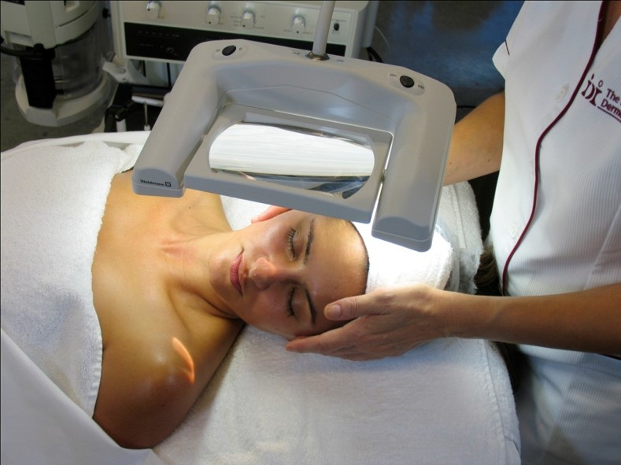
how to recognize a non-infectious skin disorder
Notes:
In addition to understanding the skin types and conditions normally present on the skin, there are some common disorders that you may encounter in the skin treatment center. It’s important to be familiar with these and to know when you may need to refer a client to a doctor for a diagnosis.
Please note that you are not a doctor and should not be diagnosing. If you suspect something could be infectious refer them to their physician or check if they have already been diagnosed.
There are many disorders, these are just a few that you may see in the treatment room to understand and be aware of.
Optional write on board – these sites are for the student’s extra research and home study:
www.skinsite.com – the Skin Site™
www.aad.org – American Academy of Dermatology

Slide 4
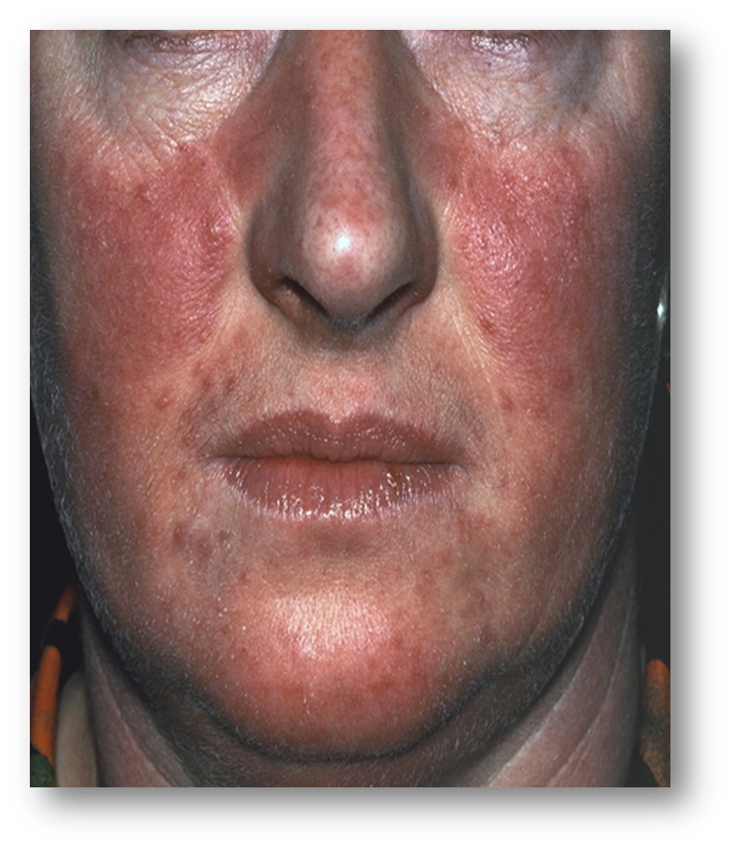
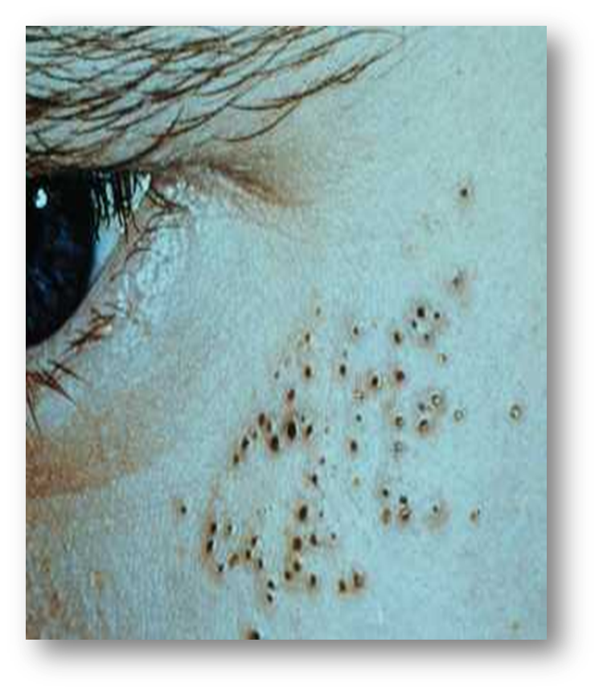
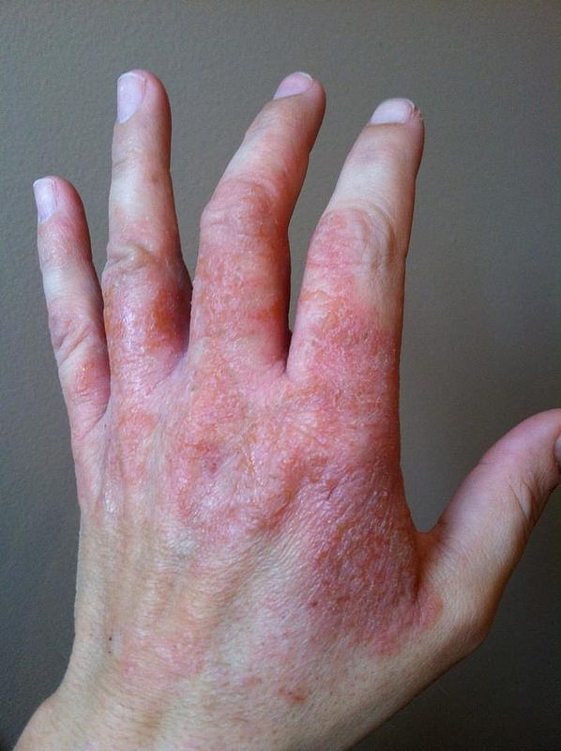
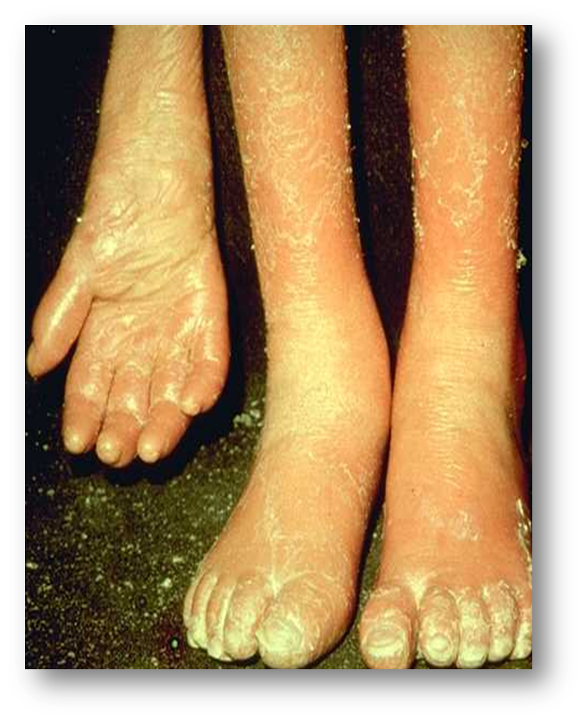
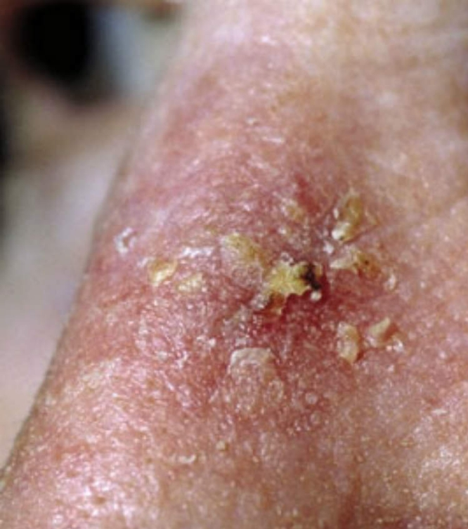
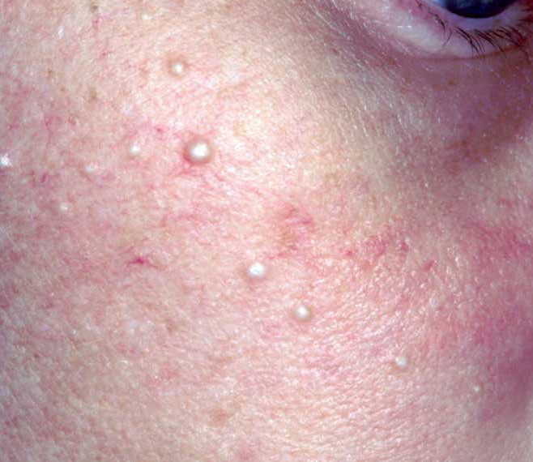
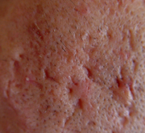
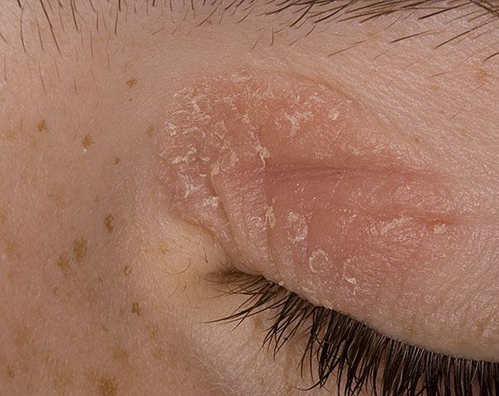
non-infectious skin disorders
Psoriasis
Eczema
Irritant dermatitis
Actinic keratosis
Solar comedones
Rosacea
Crater scars
Milia
Port Wine Stain
Notes:
This is an animated slide and as you click you will see a picture of the disorder. Briefly go over each bullet point.
Undergraduate instructor: Be sure that students understand when we treat these clients, we do not have an impact on the disorder – rather we are treating the symptoms that coincide with the disorder itself.
Psoriasis
Psoriasis is a genetic chronic skin condition and can vary in severity from mild to severe, usually affecting the nails, scalp, skin and joints and has no real known cure.
Can we treat the client? – Yes, this disorder is not contagious.
Eczema
Ranging from a small dry patch to large area of red itchy skin, it is usually worse in the creases of the elbows, knees and wrists but can also be seen on face, neck and trunk. Eczema can occur for no apparent reason due to irritation by substances such as detergents, household cleaners (Contact Dermatitis). Atopic dermatitis is usually hereditary.
Can we treat the client? – Yes, this disorder is not contagious.
Irritant Dermatitis
Inflammation of the skin when exposed to irritating or sensitizing substances. Symptoms appear within an hour after exposure or may take several days of continual exposure before symptoms manifest. Substances such as solvents, industrial chemicals, detergents, alcohol containing skin products, fragrance, tobacco smoke, paint, soaps, wool, rubber, friction, even water!
Symptoms: Burning, stinging, itching and redness.
Can we treat the client? – Yes, this disorder is not contagious.

Slide 5
Notes:
Actinic Keratosis
Due to excessive sun exposure, this is a precursor to squamous cell carcinoma (skin cancer). Areas that are most often affected: forehead, bald heads, nose and hands or anywhere that is overexposed on a regular basis. This is difficult to heal and may keep recurring. Refer immediately for treatment from a doctor if recognized or suspicious.
Can we treat the client? – Yes, this disorder is not contagious.
Milia or closed comedones
Small plugs of trapped sebum and skin cells; common around the eyes but can be anywhere on the face. Often will be a hereditary disorder or can be caused by certain ingredients in cosmetics i.e. mineral oil. Can be extracted in some states with a lancet, great care should be taken around the eye area.
Can we treat the client? – Yes, however check State Board requirements regarding lancing for extractions.
Solar Comedones
Solar comedones and cysts are caused by damage to the sebaceous glands and follicles. The follicles fill with thickened oily sebum and hardened skin cells. This results in deep nodular comedones and cysts in multiple lesions across the cheeks and around the eye area with a sour, rancid odor. Can be extracted but commonly refill. Regular exfoliation and use of refining masks recommended.
Can we treat the client? – Yes, however they will re-fill.
Rosacea is not a form of acne
Chronic disease of the skin of nose, forehead, cheeks; Marked by flushing and dilation of capillaries at surface level. Sometimes accompanied by small pustules and papules. Rosacea can be irritated by spicy foods, alcohol, extremes of temperature, stress, and certain foods. No real known cause or cure to date; Rosacea may be hereditary
Can we treat the client? – Yes treat with the “less rule.” Always recommend sunscreen and barriers to the environment. No harsh exfoliation.
Crater Scars
Some of the most severe forms of scarring as a result from acne. This is scar tissue that forms at the sight of a ruptured follicle. With deep lesions, once the follicle has burst, the white blood cells come in to clear up. Unable to distinguish good tissue from bad, the WB cells eat away at the collagen and the ground substance causing permanent dents in the skin. This scar tissue often appears pink and bulky at the surface of the skin.
Can we treat the client? – Yes.

Slide 6
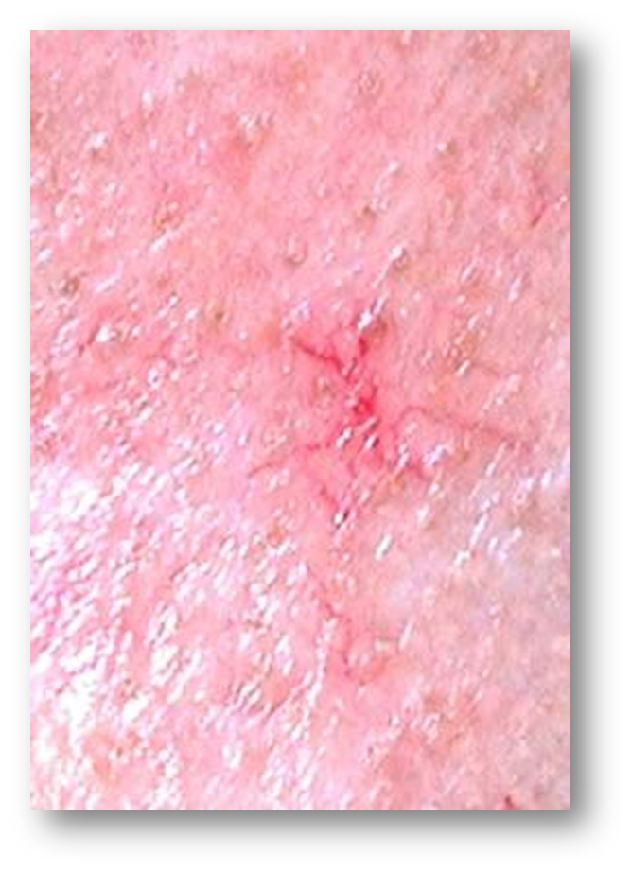
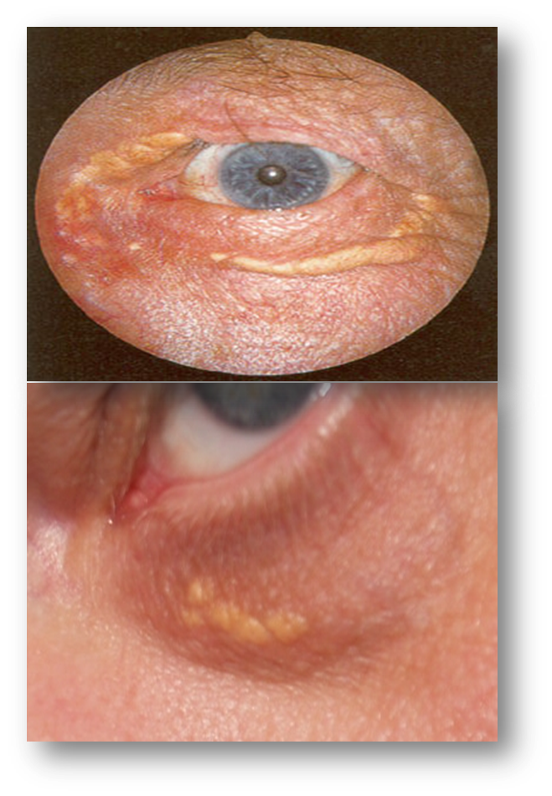
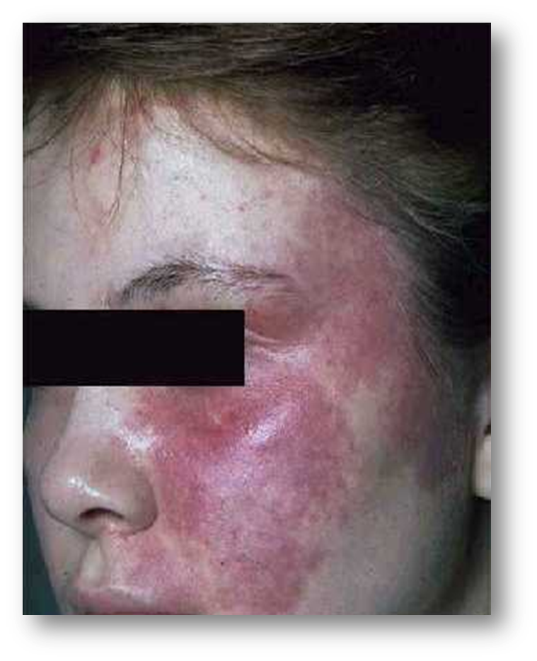
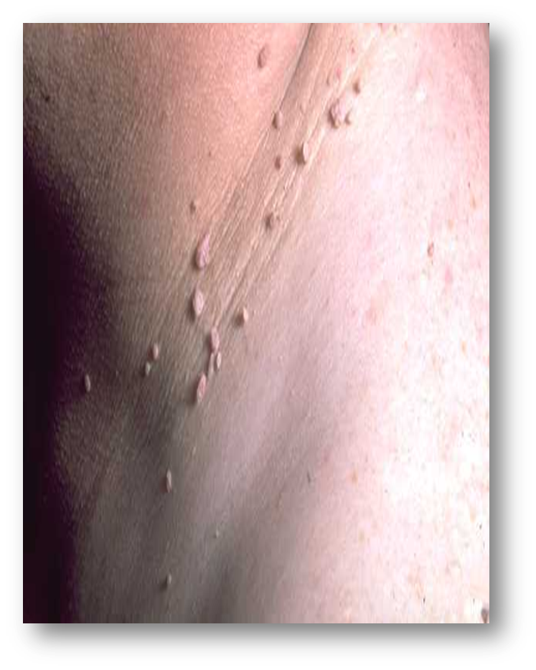
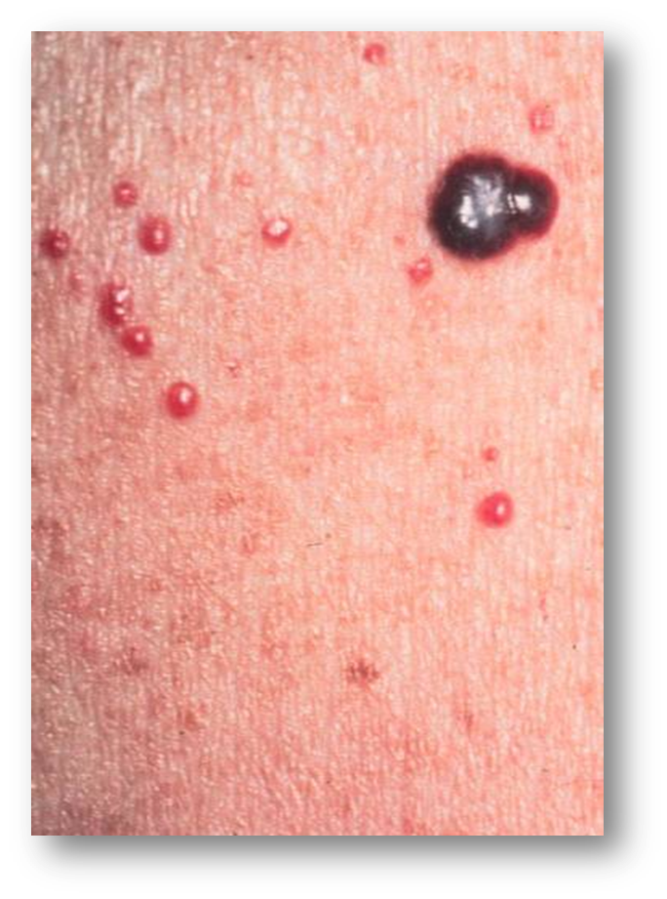
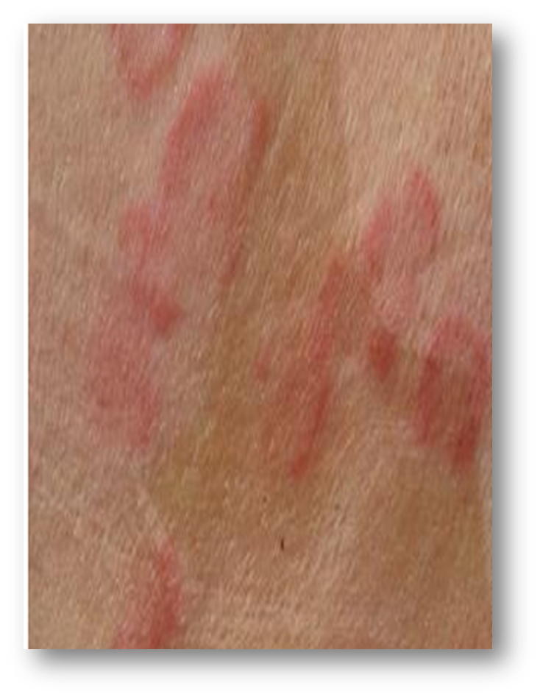
non-infectious skin disorders
Port wine stain
Skin tags
Cherry angioma
Telangiectasia
Hives
Xanthelasma
Notes:
This is an animated slide and as you click you will see a picture of the disorder.
Briefly go over each bullet point
Port Wine Stain
Mostly from birth, can fade or get smaller. In some cases they completely disappear. They can be treated with Laser to remove fully. Make-up is often used as an alternative, if not too dark or large.
Can we treat the client? – Yes, this disorder is not contagious.
Skin Tags
Can be inherited, normally caused through friction. Constant irritation on an area will stimulate the formation of skin cells and an increase in blood supply to the area. Common sites: neck, where the collar rubs as well as bra line, anywhere constant rubbing takes place. Can be removed surgically.
Can we treat the client? – Yes, this disorder is not contagious.
Cherry Angioma
A localized overgrowth of blood capillaries, some areas maybe slightly raised. Can be removed by Laser or covered with make-up, found anywhere on face or body.
Can we treat the client? – Yes, this disorder is not contagious.
Telangiectasia
If telangiectasia is present, the capillaries' elasticity is deteriorated so they remain slightly dilated. The constant influx of blood perpetuates this slight dilation. The skin gradually becomes congested and eventually the capillaries become visible through the skin's surface.
Can we treat the client? – Yes, this disorder is not contagious.
Hives, or the medical term 'Urticaria' is a common allergic reaction on the skin. It is characterized by raised, red skin welts that are more than 5mm in diameter. Hives are extremely itchy, and often have a pale border surrounding the red area.
Can we treat the client? – Yes, this disorder is not contagious.
Xanthelasma are small bumps or plaques on the skin. These lesions begin as flesh colored to yellow orange plaques on the eyelids. Normally due to abnormal blood fats. Can be hereditary, or high cholesterol in diet. Sometimes seen over other areas of the face, especially the cheek area. Unfortunately, with this condition, modifying the diet does not generally work. Lesions can be taken off with Carbon Dioxide Laser or burned off with acid in a doctor’s office.
Can we treat the client? – Yes, this disorder is not contagious.

Slide 7
carcinomas
Non-cancer effects
Basal cell carcinoma
Squamous cell carcinoma
Malignant melanoma
Notes:
As a skin therapist, we are not able to diagnose skin cancer, but we should be able to recognize a possible cancerous lesion on our client’s skin, so we can refer to a medical practitioner…
These are the most recent skin cancer statistics from the National Cancer Institute http://www.cancer.org
Undergraduate instructor: Highlight and discuss a few of the following bullet points
Each year in the U.S. over 5.4 million cases of nonmelanoma skin cancer are treated in more than 3.3 million people.
Each year, there are more new cases of skin cancer than the combined incidence of cancers of the breast, prostate, lung and colon.
Over the past three decades, more people have had skin cancer than all other cancers combined.
One in five Americans will develop skin cancer in the course of their lifetime.
One person dies of melanoma every hour (every 54 minutes).
On average, a person’s risk for melanoma doubles if he or she has had more than five sunburns.
Regular daily use of an SPF 15 or higher sunscreen reduces the risk of developing squamous cell carcinoma by about 40 percent and the risk of developing melanoma by 50 percent.
More people develop skin cancer because of tanning than develop lung cancer because of smoking.
Websites for students to research:
Skincancer.org
Cancer.org
IARC – the International Agency for research on cancer

Slide 8
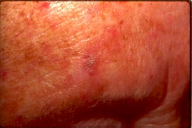
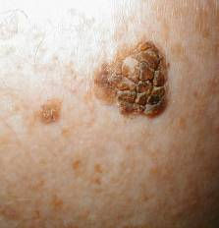
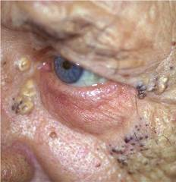
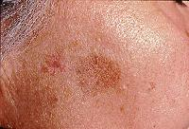
non-cancerous effects
Actinic keratosis
Seborrheic keratosis
Favre-Racouchots
Solar lentigo
Photo toxicity
Notes:
Let’s start with typical non-cancerous sun related effects…(from top to bottom)
Actinic Keratosis
The most common sun-related growth, with the potential to develop into skin cancer (therefore treatment is indicated). Caused by cumulative sun damage, they first appear as smooth, flat or slightly raised pink spots – which develop into scaly, irregular lesions that are reddish or brown in color.
Seborrheic Keratosis
The most common benign tumor in older individuals. They develop from an over-proliferation of epidermal cells, typically in sun exposed areas of the skin.
They appear as warty looking lesions that appear to be "stuck on" the skin. They do not become cancerous.
Solar comedones (Favre Racouchots)
A disorder of the Sebacesous gland consisting of multiple open and closed comedones due to chronic, excessive UV exposure – also associated with heavy cigarette smoking. Follicles fill with thickened sebum and dead cells, which results in a rancid odor when extracted. They occur around the cheeks, eyes, and in creases. (Picture also shows xanthelasma).
Solar Lentigo or Liver Spot
A lentigo is a small, sharply circumscribed, pigmented area surrounded by normal-appearing skin. Lentigines may evolve slowly over years, or they may be eruptive and appear rather suddenly. Pigmentation may be homogeneous or variegated, with a color ranging from brown to black.
Phototoxicity
A skin condition similar in appearance to a sunburn or hive like lesions, caused by chemicals either internal or external that make the skin exceptionally sensitive to even minimal UV exposure. Inflammation may appear as oozing, weeping, itching skin usually 12-24 hrs after sun exposure. Compounds include Accutane and Retin-A, antidepressants, anti-fungals, saccharine, Benzoyl Peroxide, blood pressure medication, diuretics, estrogens, Bergamot, Lime, and tranquilizers.
Now let’s learn more about the carcinogenic effects of UV.

Slide 9
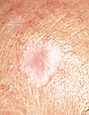
basal cell carcinoma
Mostly occurs on sun exposed areas
Grows slowly, does not itch or hurt
Edges may have blood vessels, center a dimple
Caused by many years of sun, proliferation of cells from the basal layer
Also known as “rodent ulcer”
Notes:
Basal Cell Carcinoma
The most common and least dangerous form of skin cancer – accounts for up to 80% of all skin cancers
What causes Basal Cell Carcinoma?
It is caused by skin damage from the sun that has occurred over many years prior to the appearance of the cancer. A proliferation of basal cells that grow upwards from the Stratum Germinativum. Actinic Keratosis can lead to basal cell cancer.
What increases the risk of basal cell carcinoma?
People with fair skin complexion, blue or green eyes, blonde or red hair.
Excessive exposure to sunlight
Caucasian people and outdoor workers
After the age of 40
It is also known as a rodent ulcer as it will eat through bone, tissue and skin
Less than 1% of cases show a spreading of the cancer to another site in the body. Early treatment results in a cure rate of 95%
Appearance of basal cell carcinoma:
A pink growth with a slightly elevated rolled border and a crusted indentation in the center. As the growth slowly enlarges, tiny blood vessels may develop on the surface.
A crusty sore that bleeds, oozes, or crusts and remains open for 3 or more weeks. A persistent, non-healing sore is a very common sign of an early basal cell carcinoma.
A scar-like area which is white, yellow or waxy, and often has poorly defined borders. The skin itself appears shiny and taut. Although a less frequent sign, it can indicate the presence of an aggressive tumor.

Slide 10
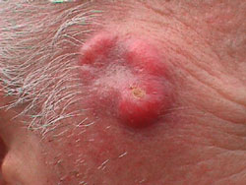
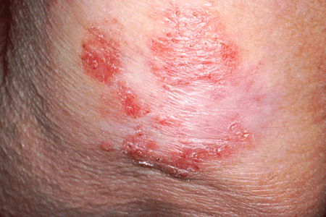
squamous cell carcinoma
16% of skin cancers
Mostly occurs on sun exposed areas
May spread to other sites in the body if left untreated and will also disfigure
Caused by exposure to sun, x-rays and chemicals, proliferation of cells from the spinosum layer
Notes:
Squamous Cell Carcinoma (SCC)
Not as dangerous as melanoma. It often appears on top of the nose, forehead, lower lip, and/or hands. Looks like a crusty, scaly patch with a hard raised, callus surface. Cancer may spread to other sites in the body if left untreated and will also disfigure.
What causes squamous cell carcinoma?
Squamous cell carcinoma is the result of sun damage; it originates from the squamous cell layer (stratum spinosum or “spiny layer”) and protrudes outwards. Squamous cell carcinoma tumors may also appear in areas of the skin that have been burned, exposed to chemicals, or had x-ray treatments. Actinic keratosis can lead to squamous cell carcinoma.
What increases the risk of basal cell carcinoma?
Fair skinned, blonde or red hair
Outdoor workers
The use of immunosuppressant medication
An occupation requiring excessive exposure to x-rays
95% curable like basal cell if caught early.
Appearance of Squamous Cell Carcinoma:
Small, smooth, shiny, pale, or waxy lump
Firm, red lump
Sore spot or lump that bleeds or develops a crust or a scab
Flat red spot that is rough, dry, or scaly and may become itchy or tender
Red or brown patch that is rough and scaly

Slide 11
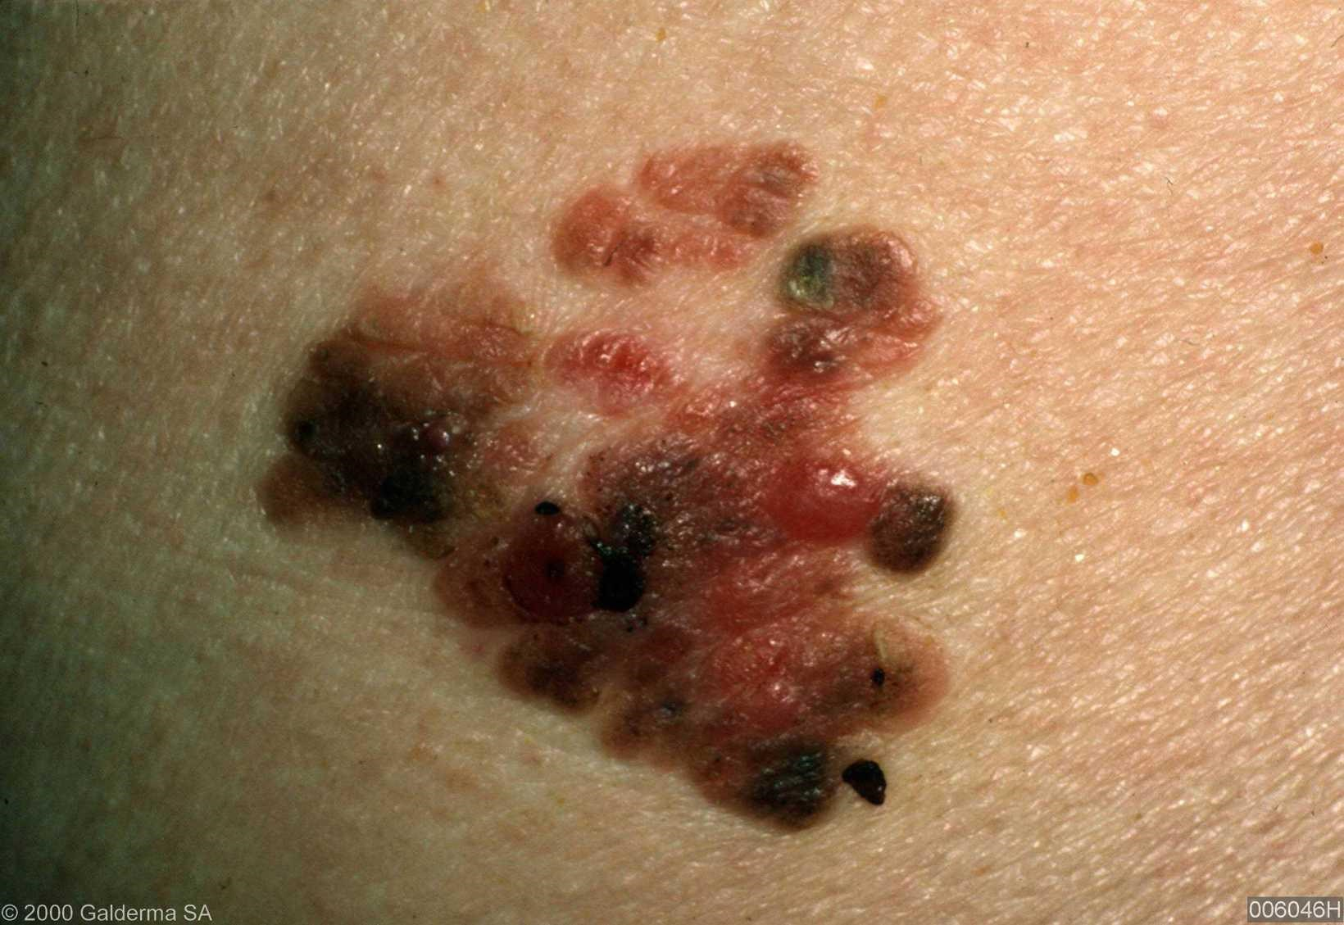
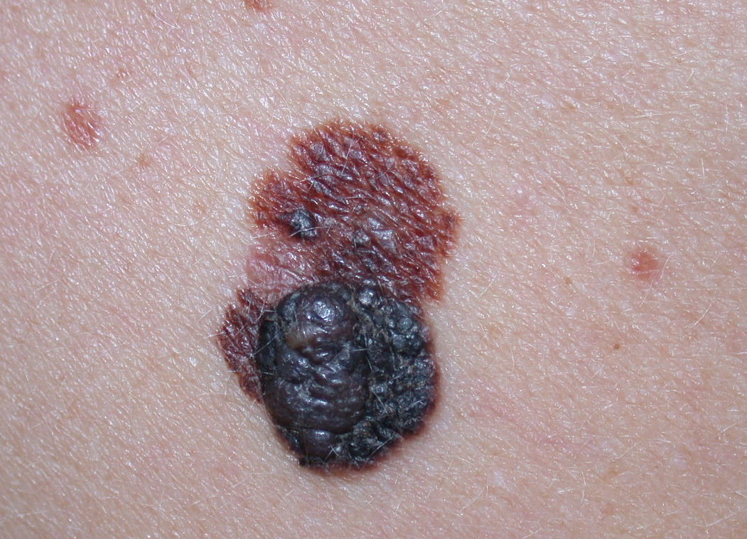
malignant melanoma
Not restricted to sun exposed areas
Can occur anywhere on the body as an irregular patch
Color varies from tan to black; also white, red or blue
Caused by uncontrolled proliferation of melanocytes
Notes:
Malignant melanoma
Melanoma is often curable if it is detected and treated in its early stages. In men, melanoma is found most often on the area between the shoulders and hips or on the head and neck. In women, melanoma often develops on the lower legs. It may also appear under the fingernails or toenails or on the palms or soles. The chance of developing melanoma increases with age, but it affects all age groups and is one of the most common cancers in young adults. It is very invasive and it can spread quickly if undetected. It is fatal if not caught in time.
Signs of melanoma:
A skin growth that increases in size and looks pearly, translucent, tan, brown, black, red, pink, or multicolored.
A mole that changes in color or in texture, becomes irregular in shape, gets larger, or is bigger than a pencil eraser.
A spot or growth that continues to itch, hurt, crust, scab, erode, or bleed.
An open sore that lasts for more than 4 weeks, or heals and then reopens.
A scaly or crusty bump that is horny, dry, and rough and may produce a pricking or tender sensation.
What causes Melanoma?
Caused by the uncontrolled growth of melanocytes in the basal cell layer, it is more
dangerous than other skin cancers because these cells break off and can penetrate other
body tissues easily.
What increases the risk of basal cell carcinoma?
Caucasians with moles
Family history
Caucasian with fair skin is twice as likely to get this than an olive skin
Redheads and blondes are 2-4 times more likely to develop melanoma
Excessive sun exposure in the first 10-15 years of your life will triple your chance of development

Slide 12
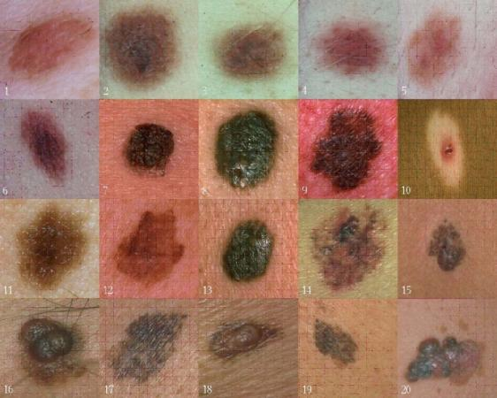
know your ABC’s
Asymmetry
Border
Color
Diameter
Enlargement
Feeling
Growth
Notes:
Since moles may develop into melanoma or indicate an increased risk for melanoma, it is important to know the difference between melanoma and an ordinary mole. An ordinary mole is usually an evenly-colored brown, tan, or black spot in the skin. It can be either flat or raised, round or oval. Moles are generally smaller than a pencil eraser (1/4 inch) in diameter. They may be present at birth or appear during childhood or adulthood. Several moles may appear at the same time, especially in areas that have been exposed to the sun. Once a mole develops, it usually stays the same size, shape, and color for several years. Most people have moles that are almost always harmless. However, it is important to recognize changes in a mole that may suggest melanoma is developing. The following ABCDEFG system can help tell a normal mole from one that could be melanoma. A = Asymmetry: Melanoma lesions are typically asymmetrical, whereas benign moles are typically round and symmetrical.
B = Border: Melanoma lesions frequently have uneven or irregular borders (i.e., ragged or notched edges), whereas benign moles have smooth, even borders.
C = Color: Melanoma lesions often contain multiple shades of brown or black, whereas benign moles are usually a single shade of brown.
D = Diameter: Early melanoma lesions are often more than 6 mm in diameter, whereas benign moles are usually less than 6 mm in diameter.
E = Elevation or enlargement.
Newly added: F = Feeling or change in sensation e.g. itching or unusual sensation. G = Growth. Noticeable increase in size.
It is worth noting that some melanomas do not conform to the A-B-C-D-E-F-G criteria, so any suspicious mole should be examined by a Dermatologist.

Slide 13
questions?
Notes:
Use this time to open up the classroom for any questions the students may have. You may also want to develop a list of review questions to ask the group in order to test retention of material presented.

Slide 14
acne
a genetic disease causing the malfunction
of the pilosebaceous unit
Notes:
What is Acne?
A genetic disease causing the malfunction of the pilosebaceous unit, characterized by any lesions from comedones to pustules to cysts. Acne is the term used to describe clogged pores and pimples, including cysts or nodules that occur on the face, neck, chest, back, shoulders and even the upper arms. Acne affects most teenagers to some extent. However, the disease is not restricted to any age group; adults in their 20s – even into their 40s – can get acne. While not a life-threatening condition, acne can be upsetting and disfiguring. When severe, acne can lead to serious and permanent scarring. According to the American Academy of Dermatology, acne is the most common skin disorder in the United States. Based upon studies, approximately 85% of people between the ages of 12 and 24 experience at least minor acne.
The American Dermatologist Association finds that:
60 million Americans have active acne
17 million adults are diagnosed with acne in the US (keep in mind that these are the ones that have sought help)
40-55% of adults between the ages of 20-40 years old have a low grade, persistent acne
54% women 25yrs+ have acne
Only 11% of acne sufferers seek help
Acne affects people regardless of age, gender or race.
So what are people doing to help treat and clear their skin?
40% really do nothing about it…they feel it will clear up on its own (a large percentage could use the help of a PST!)
30% use over the counter products
20% go to a skin center (Many people with acne, do not have the luxury or budget to seek medical help. This is another opportunity to highlight our ability to help with this disorder with our services and products.)
10% seek a doctor’s help
Link: there are 4 contributing factors to acne
References:
http://www.statisticbrain.com/acne-statistics-papule-pustule-nodule/
https://www.aad.org/media-resources/stats-and-facts/conditions/acne
http://www.acne-resource.org/understanding-acne/acne-statistics.html
http://www.bloomberg.com/apps/news?pid=conewsstory&tkr=COPN:SW&sid=aK0MBQHKoXhs
http://www.businesswire.com/news/home/20100507005977/en/Research-Markets-Global-Acne-Market-Estimated-Reach
http://www.nature.com/jid/journal/v134/n6/full/jid2013446a.html
Bhate K, Williams HC. Epidemiology of acne vulgaris. Br J Dermatol. 2013Mar;168(3):474-85

Slide 15
four contributing factors
The follicle
Cell proliferation
Bacteria
Sebum
Notes:
The 4 main factors that contribute to acne pathology are:
1. The type of follicle and hair found within
2. The skin cells and how many are produced and retained
3. Sebum which differs in acne skin
4. The bacteria found in the follicle and how it behaves
Link: let’s discuss each one more in depth

Slide 16
the follicle
Three types of follicles found in the skin:
vellus follicle
sebaceous follicle
terminal follicle
Notes:
Let’s begin by discussing the follicle.
Vellus follicles: Vellus follicles are follicles with small openings at the surface of the skin, each follicle containing a tiny hair and sebaceous glands. Some investigators believe that vellus follicles are seldom involved with acne
Sebaceous follicles: comprising a tiny hair and larger multi lobed sebaceous gland
Terminal hair follicles: comprising a long, stiff, thick hair and a proportionately sized sebaceous gland
The sebaceous follicles are the only ones involved in acne, although the other types contribute to the amount of lipids on the surface of the skin.
Sebaceous follicles are found only on the face, upper arms, chest and upper back, and acne vulgaris can only occur in these areas. Sebum spreads from the sebaceous follicle onto the hair and skin. It prevents hair from drying out and keeps skin supple. It also inhibits the growth of certain bacteria. Beard follicles are follicles from which long, coarse beard hairs grow. Beard follicles are seldom involved in acne – because the beard hair acts like a wick helping to drain sebum from the follicle and thus preventing obstruction of the follicle. However hair follicles can become infected with bacteria (in grown) which we refer to as Psuedofolliculitis Barbae.
The problem with these sebaceous follicles is that we are still producing waste build up within the follicle but have no wick in order to get rid of it…thus congestion builds.
Note: We are not saying that all acne skins do not have a hair, but rather that a thin vellus hair may not be able to wick out the sebum that is produced in the sebaceous follicle in an acne skin.

Slide 17
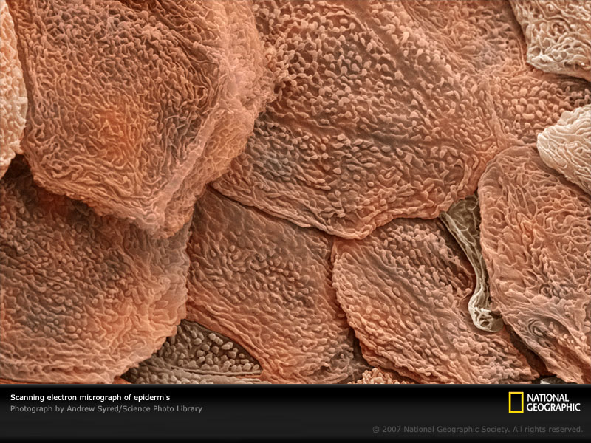
cell proliferation
retention hyperkeratosis
Due to a proliferation of cells produced in the follicle that are retained
Less lamellar granules means less enzymes to aid in desquamation
Excess dead skin cells combine with excess sebum to form an impaction plug
Notes:
Let’s explore cell proliferation now in more detail…
An over-proliferation of skin cells causes many problems from Psoriasis to acne development. We naturally produce a million dead skin cells about every 40 minutes or 36 million per day and naturally desquamate them, but in acne, the story is quite different. The process goes awry in acne as the keratinocytes (dead cells) are being produced at an abnormally rapid rate at least 4-5 times that of the normal follicle
Retention Hyperkeratosis is the retention of dead skin cells and the proliferation of additional cells in the follicle of acne prone families.
Lamellar Granules are present in the epidermal cells of the Stratum Corneum - they secrete their lipid contents into the intercellular space in the Stratum Corneum. The enzyme cholesterol sulfatase modifies the lipids, which assists, not only in proper hydration of the epidermis, but in the desquamation process itself. This process keeps the Stratum Corneum at its proper cell thickness. There are fewer lamellar granules in an acne skin, therefore the skin cells are not as easily shed – forming an impaction plug.
Link: Let’s look at some ingredients that target cell proliferation.

Slide 18
ingredients for cell proliferation
Hydroxy Acids
Sulfur
Enzymes
Retinoids
Potassium Azeloyl Diglycinate
Bambusa Arundinacea (Bamboo) Stem Extract
Maris (Sea Silt) Extract
Notes:
Instructor—these are just a few examples.
Hydroxy Acids (Salicylic Acid, Lactic Acid, Mandelic Acid, Phytic Acid, Glycolic Acid): provide exfoliation and resurfacing to the skin. Salicylic Acid is also anti-inflammatory and aids in exfoliation.
Sulfur: Clears skin by eliminating bacteria associated with acne and by clearing excess oil and congestion in the follicle. When used topically, Sulfur acts as a keratolytic agent, breaking down keratinized cells at the surface of the skin and promoting cellular turnover.
Enzymes: Papain and Bromelain, Aminopeptidase enzymes digest keratin protein.
Retinoids: Retinol (Vitamin A) can assist with cell regeneration and exfoliation.
Potassium Azeloyl Diglycinate: a water-soluble derivative of Azelaic Acid, reduces formation of comedones and normalizes abnormal development of skin cells around the follicle. It also decreases sebum as well as being anti-bacterial and anti-inflammatory.
Bambusa Arundinacea (Bamboo) Stem Extract: Known in traditional Indian medicine as Tabasheer, the nodes on the Bamboo Stem are more than 75% Silica and provide superior physical exfoliation for improved skin tone and brightening.
Maris (Sea Silt) Extract: Sea Silt: mineral rich physical exfoliant that helps to detoxify and soften the skin.
Link: Now that we’ve covered hyperkeratosis, let’s move on to Propionibacterium acnes, otherwise known as P. acnes.

Slide 19
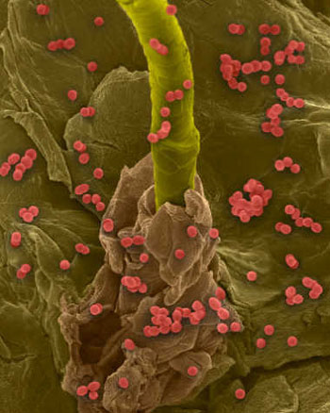
bacteria
Propionibacterium acnes – P. acnes
Good vs. bad
Biofilm clusters and colonies
Notes:
Propionibacterium acnes (P. acnes)
This bacterium is part of the natural skin flora. P. acnes is an anaerobic bacteria that prefers low oxygen environments (like deep inside a plugged follicle) and feeds on the sebum produced by the sebaceous glands. Several studies have indicated that specific strains of P. acnes bacteria are more commonly associated with acne prone skin versus normal skin, which may point to why some individuals are more predisposed to breakout while others are not.
Good vs. bad
The bacteria that causes acne lives on everyone’s skin, and some people are lucky enough to only develop an occasional pimple. Each of us have our own unique microbiome to our skin and the bacteria that’s present on your friend’s skin may not be present on yours. A UCLA study has discovered that P. acnes bacteria contain "bad" strains associated with pimples and "good” strains that may protect the skin.
Researchers were able to uncover three specific strains of P. acnes. There were two found to be dominant in acneic skin and one strain in healthy skin.
RT4 and RT5 had a strong association with acne.
RT6 was found to be in normal skin, researchers are looking into the idea that this P. acnes strain may actually protect the skin.
Biofilm clusters and colonies
These are clusters of bacteria that are attached to a surface and are embedded in a slime layer on that surface. They are produced by the bacteria and serve as a natural self-protection mechanism. The biofilm produced by P. acnes surrounds the microbes and improves its adherence to the follicle and can further promote hyperkeratinization. This may be the reason why some antimicrobial agents used in acne therapy do not work successfully, which is fueling research to develop targeted therapies to reduce the impact of biofilms in acne vulgaris. The biofilm formation is a natural occurrence and appears to be resistant to antibiotics, a common therapy for the treatment of acne. Bacteria in the protected microenvironment of a biofilm can be almost 50 times more resistant to antibacterial therapies including topical and oral medications.
Extra Teachers Reading:
Like human cells, the P. acnes bacteria produce porphyrins, which exhibit fluorescence properties and make bacteria visible with a Wood’s lamp as we can see here in the bottom photo. Porphyrins are groups of organic compounds that play major roles in processes such as oxygen transportation and photosynthesis. P. acnes synthesize and store large amounts of Porphyrins that ultimately plays favor to LED treatments, using a blue light to treat acne. The blue light excites the Porphyrins that causes them to release free radicals into the bacteria thus killing them from the inside out.
References:
http://cosmeticsurgerytimes.modernmedicine.com/cosmetic-surgery-times/news/modernmedicine/modern-medicine-news/study-sheds-new-light-biofilms
http://dermatologytimes.modernmedicine.com/dermatology-times/RC/acne/p-acnes-biofilm-impacts-antimicrobial-agents
Jahns AC, Lundskog B, Ganceviciene R, et al. Br J Dermatol. 2012;167(1):50-58
http://www.ncbi.nlm.nih.gov/pubmed/17399956
http://www.nature.com/jid/journal/v133/n9/full/jid201321a.html
http://newsroom.ucla.edu/releases/new-study-could-explain-why-some-243582
http://dermatologytimes.modernmedicine.com/dermatology-times/news/skin-metagenomics-reveals-acne-insights?page=0,0
http://dermatologytimes.modernmedicine.com/dermatology-times/content/tags/acne/acne-s-good-bacteria-battles-bad
http://aobiome.com/news&item=70
Link: So what can we do to help target the bacteria?

Slide 20
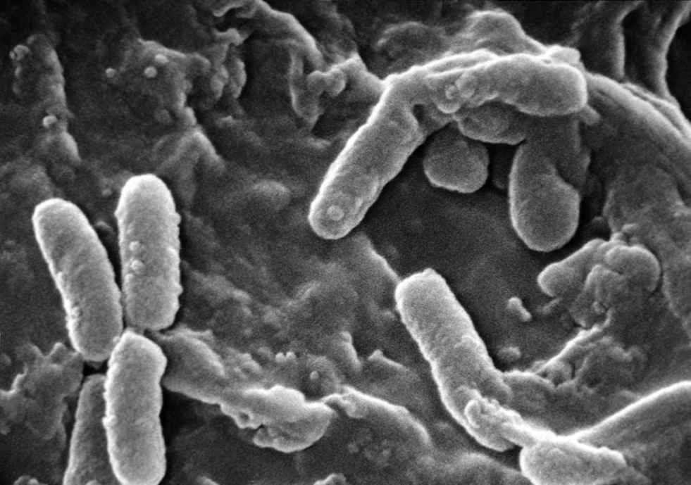
ingredients to control bacteria
Colloidal Silver
Lactobacillus Ferment
Benzoyl Peroxide
Tea Tree
Cinnamon Bark
Spirea Ulmaria
Japanese Knotweed
Notes:
Instructor – These are just a few examples.
Colloidal Silver: is toxic to the bacteria in acne, therefore it helps to eliminate bacteria and control acne.
Lactobacillus ferment: a non-pathogenic bacteria that stimulates growth of healthy bacteria and controls bacteria that causes acne breakouts and it reduces redness.
BPO: Benzoyl Peroxide eliminates breakout causing bacteria in the follicles.
BPO/Resveratrol Combination: researchers found that all concentrations of benzoyl peroxide killed the bacteria, but that these effects were not sustained past 24 hours. Conversely, resveratrol inhibited bacteria’s growth for a longer period of time rather than killing the bacteria. Together these two ingredients kill the bacteria initially and prevent development of future bacteria.
Tea Tree Oil: is commonly used as a topical antimicrobial agent. The antiseptic properties of Tea Tree Oil are thought to be due to its ability to disrupt the bacterial membrane.
Cinnamon Bark: excellent for treating acne, inhibits bacteria and bacterial lipid metabolism.
Spirea Ulmaria: inhibits bacteria by stimulating the skin’s natural anti-bacterial agents.
Polygonum Cuspidatum (Japanese Knotweed) Root Extract: rich in polyphenols, it inhibits P. acnes and helps control sebum production. It also has anti-inflammatory properties.
Link: let’s move on to our understanding of sebum and more importantly the Sebaceous Gland.
References:
http://dermatologytimes.modernmedicine.com/dermatology-times/news/alterative-treatment-options-acne?page=0,1
http://mashable.com/2014/10/02/bacteria-acne-cure/#27UwQj5q2Oqq
http://www.cosmeticsandtoiletries.com/formulating/function/antimicrobial/Researchers-Report-Anti-acne-Effects-in-Resveratrol-278655711.html#sthash.12SlfUsR.dpuf

Slide 21
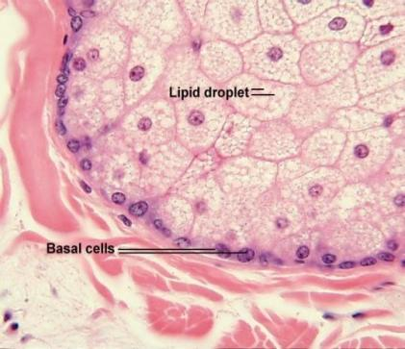
the sebaceous gland
Under the influence of testosterone
Reacts with 5-alpha reductase
Thicker, stickier sebum in acneic skin
Sebum is rich in waxes and esters that provide a favorable environment for bacteria to flourish
Notes:
The sebaceous gland is surrounded by a basal membrane where cells containing relatively small amounts of lipids adhere. After detachment from the basal membrane, the cells fill up more and more with lipids. Their volume grows more than hundred-fold until they finally burst and cause the sebum to be expressed into the hair follicle.
We know that sebum is largely under the influence of hormones and how this occurs is understood in the following way:
The hormones that have the most influence on acne are the androgens (male hormones). The process of hormonal influence on sebum production is due to Testosterone reacting with the enzyme 5-alpha reductase. This reaction turns testosterone into a more active androgen called Dihydrotestosterone (DHT). DHT binds to the receptor on the sebaceous gland, triggering sebum production to go into overdrive and also creating sebum with a stickier, more butter like consistency. There is a clear correlation between the occurrence and severity of acne and the sebum secretion rate. The average sebum secretion rate for all subjects with acne is three times that for patients without acne. Sebum tested from acneic patients also differs in composition to that of a normal skin.
Testosterone + 5-alpha reductase = Dihydrotestosterone = increased sebum production, with stickier and thicker consistency
New research has revealed that the enzyme may increase its sensitivity to the amount of testosterone present and increase sebum production when testosterone levels have not increased. We do not know why this happens, but it may explain why excess sebum occurs when testosterone levels are constant.
If we look at this, what do we need to do to cut down on sebum production?
Stop the action of 5 alpha reductase.

Slide 22
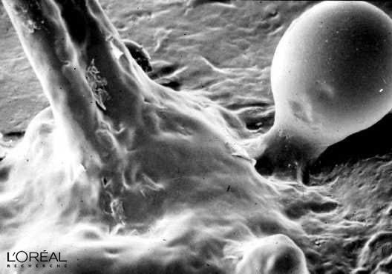
ingredients to reduce sebum
Nordihydroguaiaretic Acid
Niacinamide
Retinoic Acid
Zinc Gluconate
Caffeine
Lentil Seed Extract
African Whitewood Bark Extract
Green Tea
Activated Binchotan Charcoal
Notes:
Instructor—these are just a few examples.
Nordihydroguaiaretic Acid: regulates sebaceous activity and cell proliferation by decreasing overall lipid formation in the sebaceous glands.
Niacinamide: assists in regulating sebaceous gland secretions by inhibiting 5-alpha reductase enzyme activity while scavenging free radicals.
Retinoic Acid: proliferating sebocytes have a receptor on their surface the binds to retinoic acid. When retinoic acid comes into contact with sebocytes, it initiates a cascade of changes by causing sebaceous glands to decrease in size and reduce their growth rate, resulting in dramatically decreased sebum production. In some cases, treatment with retinoic acid can decrease the production of sebum by up to 90%.
Zinc Gluconate: assists in regulating sebaceous gland secretions by inhibiting 5-alpha reductase enzyme activity while scavenging free radicals.
Caffeine: Assists in regulating sebaceous gland secretions by inhibiting 5-alpha reductase enzyme activity while scavenging free radicals.
Lentil Seed Extract: reduces sebum and helps control shine and smooths skin.
African Whitewood Bark Extract: has sebum regulating properties and is anti-inflammatory.
Green Tea: assists in regulating sebaceous gland secretions by inhibiting 5-alpha reductase enzyme activity while scavenging free radicals. It can be helpful in the prevention of acne, perhaps through decreasing sebum production along with being a powerful antioxidant with anti-inflammatory properties.
Activated Binchotan Charcoal: draws out excess sebum, toxins and other impurities from the skin’s surface.
Link: Most of the damage that occurs with acne is actually due to inflammation and the trigger of the inflammatory process of the immune system.

Slide 23
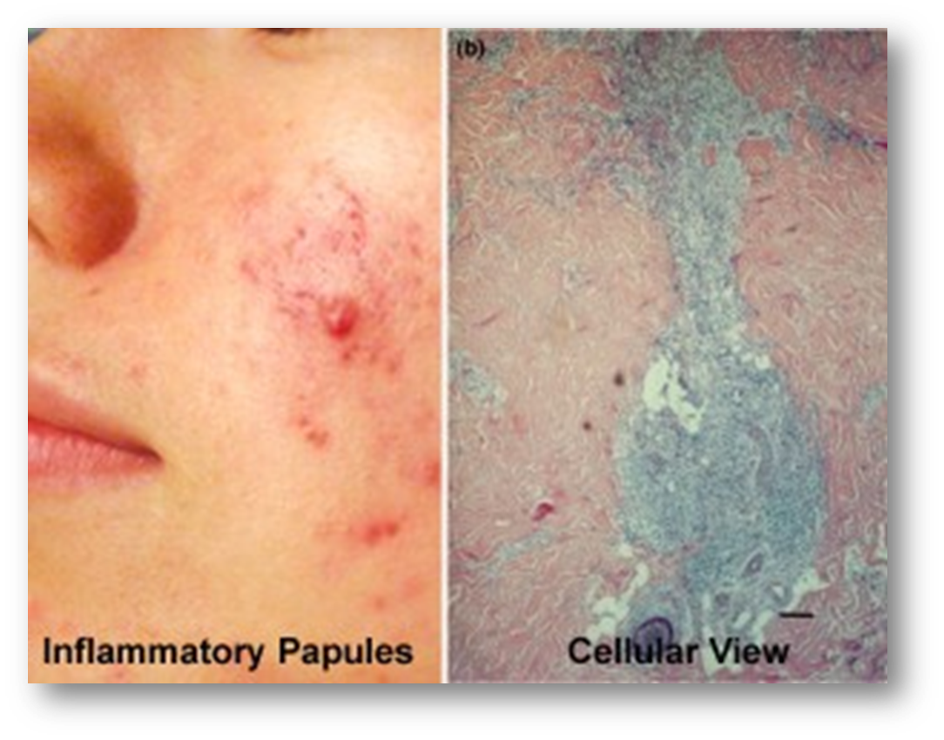
the inflammatory pathway
which comes first?
Notes:
Undergraduate Instructor: The left image shows inflammatory acne.
The right image shows a cross-section of what is happening inside the inflamed follicle with the activity of white blood cells trying to clear up the infection (blue area).
If a comedone is left untreated or extracted, it has the potential to develop into a more serious form of acne. An impacted follicle is the clogging of skin cells and sticky sebum nicely lodged into the opening of the follicle, blocking the O₂ to the base, allowing P. acnes bacteria to thrive.
In time the inflammation is going to build up within the follicle. It may result in the following:
Papules - formed by accumulation of cells in the dermis and the action of white blood cells, causing inflammation.
Pustules - formed from the action of white blood cells on the bacteria, this forms pus at the mouth of the follicle.
Nodules - a deep break in the follicle wall, spilling out debris into the dermis. This spreads to adjoining follicles and causes severe inflammation and pain. Often a nodule can lead to a cyst. This is the deepest break and the body’s response is to protect itself from the bacteria. A membrane will encapsulate the infection to stop further spreading. Nodules and cysts are always treated by a doctor or Dermatologist.
But what if this was reversed?
New research is now pointing to inflammation as possibly being regarded as the initial key component of the pathogenesis of acne. It comes down to which one really comes first? The pimple then inflammation or inflammation then a pimple? Based upon recent studies, researchers are starting to look into the process that inflammation actually precedes the formation of a comedone and that inflammation exists in some form at every stage of acne pathogenesis.
Think about it, what if by reducing inflammation via products, skin care treatments and diet, especially for acneic clients, the process of acne could be more effectively slowed down?
Link: And where we have excessive inflammation, we have scarring.
References:
http://dermatologytimes.modernmedicine.com/dermatology-times/RC/acne/acne-research-goals-should-focus-inflammation?page=0,2
http://www.ncbi.nlm.nih.gov/pmc/articles/PMC3780801/

Slide 24
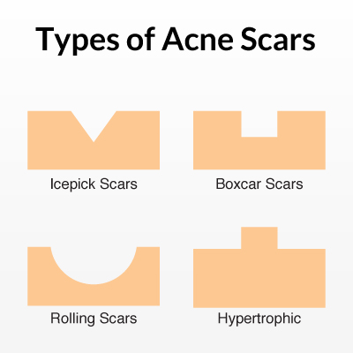
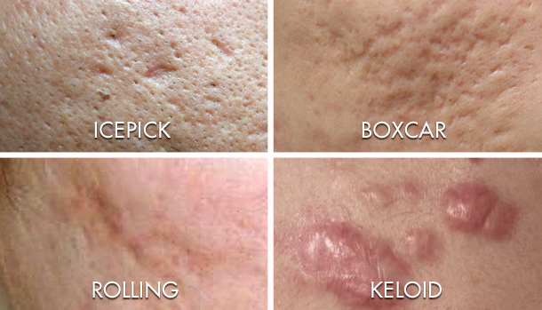
types of acne scaring
Notes:
Why does acne scarring occur? As we’ve reviewed, when acne occurs, it is accompanied by an inflammatory response that injures the skin. This injured area of skin then undergoes wound repair in which the body produces scar tissue (collagen) to heal the wound. Although, the body replaces injured tissue with the same type of tissue (collagen), scar tissue lays down collagen in a different and inferior manner compared to normal tissue collagen. This different arrangement of collagen in the body’s healing process is the key feature of scar formation.
There are two general types of acne scars, defined by tissue response to inflammation
Scars triggered by increased tissue development (i.e. keloids)
Scars caused by loss of tissue (i.e. ice-pick)
What are the different types of acne scars? [Click once for diagram and then again for photos of scars to appear]
Rolling acne scars - shallow, soft wave-like appearance recessions in the skin.
Box car scars - angular scars that usually occur on the temple and cheeks and can be either be superficial or deep. These are similar to chicken pox scars.
Ice-pick scars - appear as deep, narrow pits in the skin, and are the most common.
Hypertrophic scars - usually raised and firm. More common on the back or chest and present as thick, lumpy scars that sit above the surface of the skin and do not grow beyond the boundaries of the original wound.
Keloid scars - are larger than hypertrophic scars because they extend beyond the original area of injury to the skin. Keloids are firm, rubbery lesions or shiny, fibrous nodules and can vary from pink to flesh tone or red to dark brown in color. (not shown in the diagram but placed in photos).
Post Inflammatory Hyperpigmentation (PIH): refers to the red or dark marks that are left behind after a pimple heals. These marks are not scars but are often confused with scars because they can last for months or even years before they fade.
Link: So ultimately, we must prevent and control inflammation within the skin.

Slide 25
ingredients for inflammation
Niacinamide
EFAs & Essential Oils
Vitamin C (MAP)
Avena Sativa
Lavender
Red Hogweed
Acetyl-Tetrapeptide-15
Chilean Wild Mint
Notes:
Instructor—these are just a few examples.
Niacinamide: Nicotinamide, also known as Niacinamide, is a water-soluble B vitamin. Numerous studies have investigated the use of nicotinamide both topically and orally for acne and reasonable evidence exists for the its use topically in the treatment of acne. At 4% Nicotinamide, it has performed equally to topical clindamycin. Nicotinomide has also been shown to inhibit interleukin production, potentially explaining its anti-inflammatory properties in the skin.
EFAs-Linoleic Acid: an essential fatty acid component of Vitamin F. Skin conditioner and smoothing agent that is critical for lipid barrier function of Stratum Corneum. By repairing the skin’s barrier, hydration can be maintained and inflammation reduced.
Essential Oils: mint, clove and thyme can be anti-inflammatory and antibacterial along with Rosehip Seed Oil.
Vitamin C: is an effective alternative agent to improve inflammatory reactions in acne as well as having brightening effects and reducing PIH. Lipid peroxidation was significantly decreased on sebocytes with Vitamin C as well.
Avena Sativa (Oat Kernel) Extract: has natural anti-inflammatory properties, heals and reduces redness.
Lavendula Angustifolia (Lavender): antiseptic and reduces inflammation.
Boerhavia Diffusa (Red Hogweed) Root Extract: targets inflammation by limiting activity of pro-inflammatory agents and helps restore tissue integrity.
Acetyl-Tetrapeptide-15: decreases release of pro-inflammatory mediators, lessens skin’s reactivity and diminishes sensations of discomfort.
Peumus Boldus (Chilean Wild Mint) Leaf Extract: helps soothe and clarify the skin, reducing pore visibility.
Link: Let’s discuss additional influences that can trigger acne.
References:
http://www.ncbi.nlm.nih.gov/pubmed/26273151
https://www.truthinaging.com/review/the-babchi-plant-an-acne-fighter
http://www.ncbi.nlm.nih.gov/pubmed/12237811

Slide 26
additional acne triggers
Hormones
Medications
Cosmetics
Environment
Friction
Industrial Oils
Diet
Picking
Notes:
Activity of the sebaceous gland can also be stimulated by many additional factors, including the onset of puberty (teenage acne), hormonal fluctuations, pharmaceutical agents, stress, using inappropriate products on the skin, heat, friction, and humidity. We will go through them in more detail.
Hormones: A noticeable time where hormone levels can change is during puberty but can also occur for women during menstrual cycles and pregnancy. New studies have identified links between acne and other health issues such as hyperthyroidism in post-menopausal women and Polycystic Ovary Syndrome.
Medications: There are certain types of medications that cause acne breakouts as a side effect. For example, medications that contain iodine or bromine can cause acne like eruptions. Drugs used to treat epilepsy and depression are also known to trigger breakouts. Lithium taken for bipolar disorder, has been linked to side effects that cause precipitation or aggravation.
Cosmetics: The primary culprits in adult acne are cosmetics and hair care products that contain fragrances and plastics. Fragrances can cause contact reactions, which can lead to the development of acne. Conditioners, hair sprays and hair gels almost always contain plastics, which can block follicles and cause breakouts. The ingredients to be aware of are PVP (when used in high concentrations) and CVP. Scalp breakouts and chin acne (it is very common for a person to touch their hair and to touch their chin) are good indications that hair care products are the offenders. Many waterproof, sweat proof, or smudge proof cosmetics and sunscreens also contain these plastics. Certain ingredients used in makeup and some skin products can affect skin function and irritate the follicle lining; ingredients such as petroleum-derived mineral oil, isopropyl isosterate and myristate, acetylated lanolin and artificial colors like D&C red #30.
Environment: UV rays, change in seasons, climate, and pollution can be influences in the production of acne. Some people with acne may notice a worsening of their acne in the summer heat and humidity, or in exposure to tropical regions when on vacation or military duty. For some who work in kitchens, laundromats and industrial settings that are especially surrounded by high heat and humidity, this can increase oil production and blood flow, especially in young adults. In contrast, summer sun and dry atmosphere may improve acne for some.
Continued on next hidden slide.

Slide 27
Notes:
Friction: Acne mechanica is a form of acne caused by heat, pressure, occlusion of the skin and repetitive frictional rubbing against the skin. Synthetic fibers, areas of friction from phones (Phone acne!) to clothing can all be triggers – even hats, helmets or pads that retain sweat or moisture.
Industrial oils and chemicals: Can result from hydro-carbonated oils. Chloracne is caused when industrial chemicals called halogenated hydrocarbons come in contact with the skin. A person who gets chloracne from industrial exposure can "take it home" to other members of his or her family if the chemical is on clothing and handled by other family members.
Diet: Studies now show that dairy and sugar are linked to acne production and can trigger hormonal fluctuations. High glycemic foods have been linked to increasing insulin, which in turn, increases androgen hormones, specifically testosterone which could cause or worsen acne. Milk naturally is filled with hormones, including di-hydrotestosterone. According to some researchers, people who are genetically predisposed to acne breakouts may have a stronger reaction to the hormones in milk. These hormones bind to the sebaceous gland, which is stimulated and becomes over-active, producing even more sebum resulting in inflammation and breakouts. Milk consumption has also been demonstrated to raise serum IGF-1 (Insulin-like growth factor 1) levels in children and adults. IGF-1 is a growth factor that peaks in the human body during adolescence, when acne is usually at it's worst. It is believed that IGF-1, along with testosterone and di-hydrotestosterone trigger acne breakouts. In a study by the American Journal of Dermatology researchers found a link between drinking milk and acne and that low-glycemic index diets may improve acne. “The consumption of high-glycemic index foods appears to trigger a cascade of responses, which can lead to acne through effects on growth hormones and sex hormones.” Further research states that individuals with a diet rich in pasta, bread, and sugar experienced more acneic lesions than those who consumed grains and vegetables.
Simple carbs and sugar: Any food that leads to a spike in your blood sugar (such as pasta, bread, and sweets) can trigger the skin inflammatory response and provoke a breakout, according to Linda K. Franks, MD, a dermatologist in New York City. (Prevention article)
For those looking for solutions on foods that could be triggering breakouts, there is an app to help identify food triggers. More information can be found here http://www.medindia.net/news/new-app-exclusively-for-acne-sufferers-134141-1.htm
Picking: Poor hygiene and bad extraction techniques can lead to the spread of acne.
References:
Vergou T, Mantzou E, Tseke P, et al. Association of thyroid autoimmunity with acne in adult women. J Eur Acad Dermatol Venereol. 2011 Apr 27.
http://www.ncbi.nlm.nih.gov/pubmed/22898209
http://www.aad.org/stories-and-news/news-releases/Growing-evidence-suggests-possible-link-between-diet-and-acne
http://www.skininc.com/skinscience/physiology/Long-term-Research-Links-Dairy-and-High-Sugar-Foods-to-Acne-200252611.html
http://www.prevention.com/beauty/skin-care/adult-acne-causes-and-treatments
Extra Teachers Note:
Scientists have found a link between acne and insulin resistance, such as those patients with Polycystic Ovary Syndrome (PCOS). Due to these studies, literature is now showing the relationship between nutrition and the frequency of acne, especially with glycemic index and the consumption of dairy. More information maybe found here: http://www.skinandallergynews.com/index.php?id=372&cHash=071010&tx_ttnews[tt_news]=140673

Slide 28
understanding acne lesions
Notes:
Undergraduate Instructor: Below is suggested narration for the acne video. It is set to play automatically and is about 1 ½ minutes in length.
On the skin we have tiny openings called pores that are openings to the follicle under the skin’s surface. Connected to the follicle are sebaceous glands filled with sebocytes and this gland continuously releases oil (sebum) into the follicle. The sebum then travels up the follicle and out on to the skin.
The follicle is lined with keratin producing cells that mix with the sebum as well as P. acnes bacteria. In a functional sebaceous follicle, this mixture flows up and out of the follicle. Unfortunately, the dead skin’s cells can actually block the pore opening, and the cells, oil and bacteria cannot get out; causing an impaction.
As the pressure begins to build up, the follicle begins to expand like a balloon. As it gets larger, tiny holes can form and bacteria along with other follicle contents can leak out into the dermis.
The presence of bacteria triggers an immune response. This attracts white blood cells to come in and try to fix the problem – creating inflammation. During this time, the cells in the follicle begin to produce more keratin to try and close the opening. Next, we have more cells and more sebum that favor the growth of more bacteria; all of this building up in the follicle and eventually causing it to burst, releasing its contents and creating more inflammation in the skin. Then we begin to see the presence of acne lesions such as papules.
In some individuals, this process becomes a vicious cycle and leads to extensive acne and significant damage to the skin such as scarring.
Link: Let’s review the types of acne lesions we may see on the skin.

Slide 29
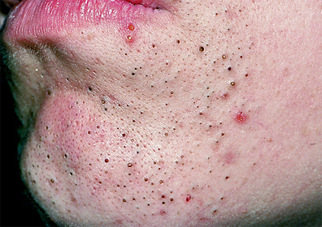
open and closed comedones
Notes:
Comedone (plural comedones)
A comedone is a sebaceous follicle plugged with sebum, dead cells from inside the sebaceous follicle, tiny hairs, and sometimes bacteria. When a comedone is open, it is commonly called a blackhead because the surface of the plug in the follicle has a blackish appearance due to oxidation. These are the most common lesions skin therapists work on. They are non-inflamed lesions at this stage and the goal of the professional is to remove them to prevent further problems and development into pimples.
Ask the group: What could we do to treat comedones? Extractions, that’s right!
A closed comedone is commonly called a whitehead; its appearance is that of a skin-colored or slightly inflamed "bump" in the skin. The whitehead differs in color from the blackhead because the opening of the plugged sebaceous follicle to the skin’s surface is closed or very narrow, in contrast to the distended follicular opening of the blackhead.
A milia is a non-inflammatory comedone with a white center (hardened sebum deposit) which may need to be lanced to extract, state law will determine if this is done by the skin therapist or not. If you cannot use a lancet, you may wish to use hydroxy acids and mechanical brush cleansing and build this in with exfoliating products to use at home.

Slide 30
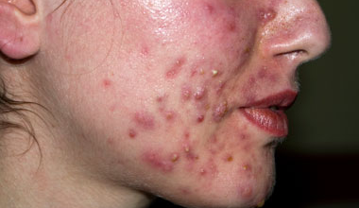
papules and pustules
Notes:
A papule occurs when there is a high break in the follicle wall, this then empties into the dermis, white blood cells attach and a sore red lesion is
felt. Papules may last 5-10 days, depending on their activity.
The papule develops into a pustule as white blood cells attack, pus is produced, and a yellow cap of pus is visible on the surface of the skin.
Pustules may last for 5 or 6 days, depending on how active they are. Both papules and pustules may resolve into a macule that can persist
for several weeks and contribute to the "inflamed" look of acne. We would not extract these lesions, however we can still offer treatments to reduce inflammation, exfoliate and treat. This level of acne may need to be referred to a dermatologist for treatment.

Slide 31
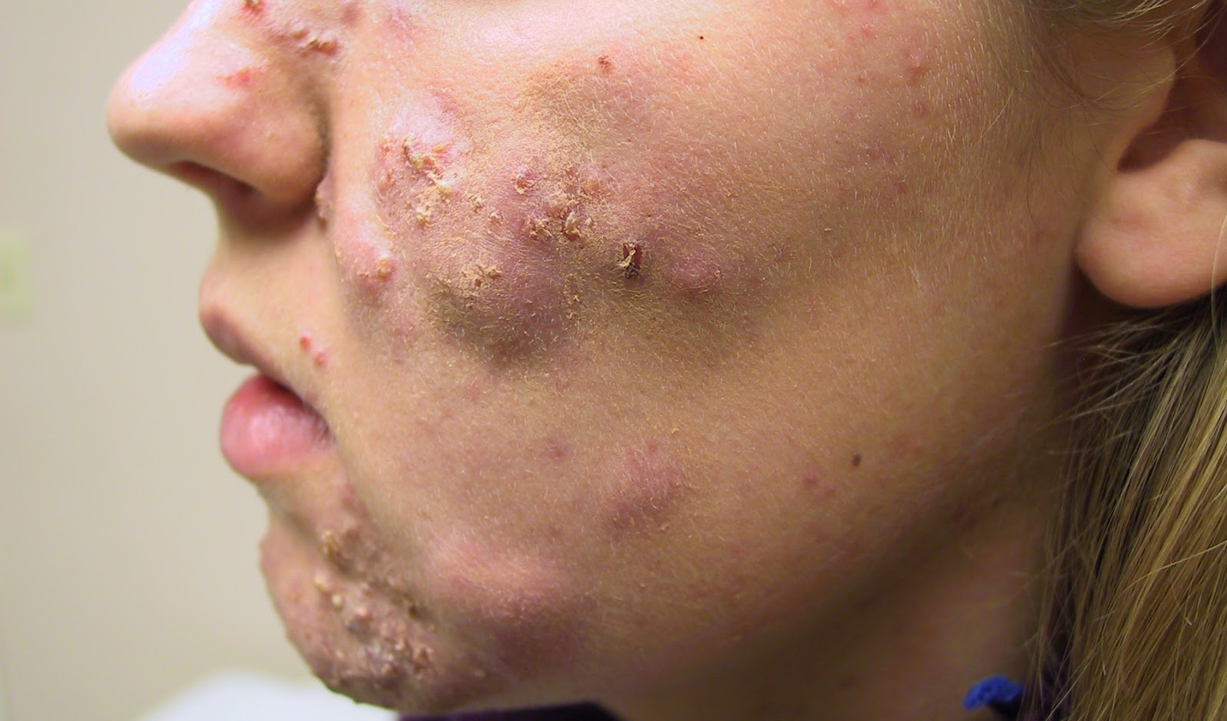
nodules and cysts
Notes:
Nodule
A nodule is a solid, dome-shaped or irregularly-shaped lesion. It is characterized by inflammation which extends into deeper layers of the skin and may cause tissue destruction that results in scarring. A nodule may be very painful. Nodular acne is a severe form of acne that may not respond to therapies other than Isotretinoin.
Cyst
A cyst is a sac-like lesion containing liquid or semi-liquid material consisting of white blood cells, dead cells and bacteria. It is larger than a pustule, may be severely inflamed, extends into deeper layers of the skin, may be very painful, and can result in scarring. Cysts and nodules often occur together in a severe form of acne called nodulocystic. Systemic therapy with Isotretinoin is sometimes the only effective treatment for Nodulocystic Acne.
We would not extract the acne lesions, but we can still give treatments. Focus on bringing down inflammation and help to speed the healing process. Oatmeal masques are excellent for addressing the swelling. We also want to recommend home care to support whatever the prescription the doctor gives. Often, clients experience sensitivity and dehydration as side effects to medical treatments. We want clients using hydrating toners and oil free moisturizers to seal and protect their skin.
Treat the person, not the acne. Try to find the root cause of the problem.

Slide 32
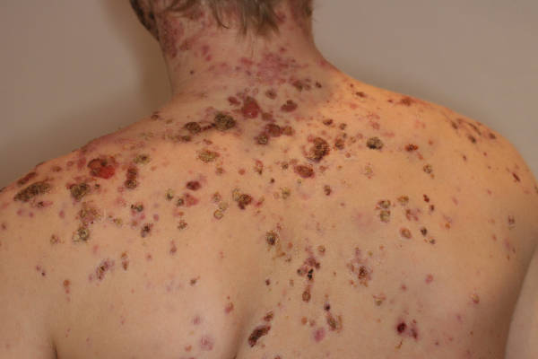
severe acne
Three types:
acne conglobate
acne fulminans
gram negative folliculitis
Notes:
Severe acne can affect many facets of a person’s life, causing a great deal of embarrassment and stress. Severe acne may significantly limit one’s social life and even interfere with opportunities for employment. Since this condition can be disfiguring and require years of treatment, it is important to see a specialist. Dermatologists have the most experience treating the different types of severe acne.
Three types of severe acne, described in detail below, are:
Acne Conglobata: This is the most severe form of acne vulgaris and is more common in males. It is characterized by numerous large lesions, which are sometimes interconnected, along with widespread blackheads. It can cause severe, irrevocable damage to the skin, and disfiguring scarring. It is found on the face, chest, back, buttocks, upper arms, and thighs. The age of onset for acne conglobata is usually between 18 and 30 years, and the condition can stay active for many years. As with all forms of acne, the cause of acne conglobata is unknown. Treatment usually includes isotretinoin (Accutane), and although acne conglobata is sometimes resistant to treatment, it can often be controlled through aggressive treatment over time.
Acne Fulminans: pictured above This is an abrupt onset of acne conglobata which normally afflicts young men. Symptoms of severe nodulocystic, often ulcerating acne are apparent. As with acne conglobata - extreme, disfiguring scarring is common. Acne fulminans is unique in that it also includes a fever and aching of the joints. Acne fulminans does not respond well to antibiotics. Isotretinoin (Accutane) and oral steroids are normally prescribed.
Gram-Negative Folliculitis: This condition is a bacterial infection characterized by pustules and cysts, possibly occurring as a complication resulting from a long term antibiotic treatment of acne vulgaris. It is a rare condition, and we do not know if it is more common in males or females at this time. Fortunately, isotretinoin (Accutane) is often effective in combating gram-negative folliculitis.
Link: Let’s now look at the grading system used by dermatologists to assess typical acne severity.

Slide 33
the 4 grades of acne
Grade 1 – mild acne
Grade 2 – mild / inflammatory papules
Grade 3 – acne vulgaris
Grade 4 – cystic acne
Notes:
Grade 1 – Mild Acne
Seen in the form of micro-comedones, closed comedones and open comedones.
Grade 2 – Mild / Inflammatory Papules
Usually seen as micro-comedones, closed comedones, open comedones and some inflammatory papules.
Grade 3 – Acne Vulgaris
Commonly seen as comedones, papules and pustules.
Grade 4 – Cystic Acne
Consists of comedones, papules, pustules, nodules and cysts.
Grade 3 and 4 may need to be addressed with oral or topical medication prescribed by a dermatologist to truly see improvements, but this does not mean that the client should not see a skin therapist. Comedones can still be addressed together with treatments to counter the side effects of prescription acne medication i.e. soothing and anti inflammatory. However if the client is not on any acne medication we can use products to assist in extraction of comedones along with recommending retail products that may help with underlying congestion.
Extreme care should be taken with Grade 4 acne; if it is infected and severe, please refer the client to first seek medical help via a dermatologist.
Link: Now let’s move on to discussing treatments.

Slide 34
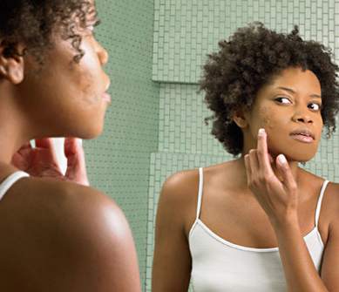
treatments and beyond
The skin therapist’s role
Lights and lasers
Medical treatments
Topical and oral treatment solutions
New trends
Notes:
Let’s review some of the ways in which to treat an acneic skin.
As a skin therapist, we must take a 360 degree approach when treating acne. Your course of treatment will depend on the consultation as well as the type of acne, and education and retailing are essential to keep your acne client on a plan towards achieving real results. Even if the acne has cleared, it takes consistency and patience to manage this skin disorder. Depending on your state board regulations, in your treatment room you may have access to a few key procedures.
Some of the techniques that may be available to you as a skin therapist are:
Deep Cleansing: We can incorporate a deep cleansing treatment including extractions on non-inflammatory comedones by using safe hygienic methods, like the IDI Extraction Technique. Incorporate galvanic (for desincrustation and iontophoresis), direct high frequency (to kill bacteria and dry lesions), ultrasonic (deep cleansing and product penetration) and/or microcurrent (specific iontophoresis) into your treatments.
Chemical Peels: Higher levels of Salicylic, Glycolic, Lactic Acids and Trichloroacetic Acid (TCA) are perfect for resurfacing the skin, clearing congestions and brightening hyperpigmentation. For acne, it’s best to perform in a series.
Hydro or Microdermabrasion: This process can remove some skin irregularities, as well as stimulate a healing process which can lead to increased collagen production and a structural improvement in the dermis. It offers some improvement in clients with mild rolling scars, mild, non-inflammatory acne, and helps to even out skin tone. This would not be used on skin with active or inflamed acneic lesions.
Light emitting diodes – LED: (Blue Light and Red Light): Blue light targets bacteria, while red light encourages healing of the skin.
Link: let’s discuss this a bit further.

Slide 35
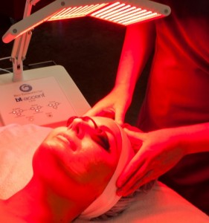
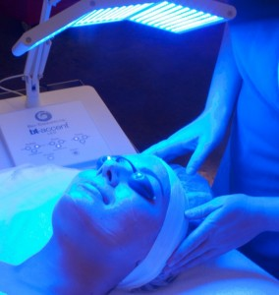
shine some light
Notes:
Light Emitting Diode (LED)
LED is a low energy, non-ablative device that emits an exact wavelength into the skin to stimulate and energize cellular activity. The theory behind LED is that energy will stimulate the skin cells in a manner similar to photo synthesis (the process of taking light and converting to food energy as plants do). There are several colors that may be selected for use, however Blue and Red light are usually used with the treatment of acne.
Blue LED
Blue light has a wavelength of 400–490 nm and has special effects on the skin especially when it comes to treating acne. Blue light can help excite porphyrins, the compounds inside P. acnes. When porphyrins are activated, they release reactive oxygen molecules that damage the bacteria internally, basically killing the bacteria from the inside out. Use of Blue LED will generally be for the treatment of acne and it can be used after extractions as an anti-inflammatory and anti-bacterial agent or over light friendly products such as clear water-based serums or masques.
[click for next images of blue and red light]
Red LED
Red Light is about 640nm on the visible light spectrum and is used to stimulate the healing process, cellular growth and collagen remodeling. Researchers suggest that since Red Light (levels of 633 nm) penetrates deeper into tissue than blue light, the red light could possibly actively destroy P. acnes bacteria found in the lower regions of the sebaceous gland. Red light has also been shown to demonstrate anti-inflammatory properties
Combination Therapy
Blue and red light dual phototherapy combines both the individual red and blue lights into one treatment. This has found to be effective by combining the antibacterial action of the blue light with the regenerative properties of the red light – making it more effective for acne skin.
References:
http://www.ncbi.nlm.nih.gov/pubmed/16766484
http://dermatologytimes.modernmedicine.com/dermatology-times/news/clinical/dermatology/blue-red-led-combo-more-effective-severe-acne?id=&pageID=1&sk=&date=&total_page=2

Slide 36
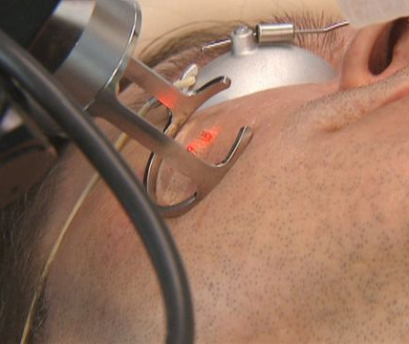
medical
Fillers and collagen
Dermabrasion
Lasers
Skin surgery and grafting
Chemical peels
Notes:
Keep in mind a dermatologist/plastic surgeon may use a combination of these therapies depending on the individual and scarring present.
Filler Substances Filler substances are best used for shallow, saucer-shaped acne scars. Restylane, Cosmoderm, Cymetra, Fasciian, Artecoll and bovine Collagen are all available. Dermabrasion.
This is thought to be the most effective treatment for acne scars. Under local anesthetic, a high-speed brush is used to remove surface skin and alter the contour of scars. Superficial scars may be removed altogether, and deeper scars may be reduced in depth. Dermabrasion does not work for all kinds of scars; for example, it may make ice-pick scars more noticeable if the scars are wider under the skin than at the surface. In darker-skinned people, dermabrasion may cause changes in pigmentation that require additional treatment.
Laser Treatment.
There are 2 major categories of laser used in acne scar therapy: ablative and non-ablative. Ablative lasers literally remove the outer layers of the skin, burning away scar tissue and stimulating the dermal collagen to tighten, reducing the amount of scar visibility. The ultrapulsed carbon dioxide laser and erbium YAG laser are most frequently used in laser resurfacing. Because the skin is injured and unprotected tissue exposed, great effort must be put into wound care and infection prevention. The skin may remain reddened for several months or a year afterwards.
Fraxel laser has revolutionized the treatment of acne scars and represents the world’s first Non-Ablative Resurfacing laser. It has the ability to promote collagen growth in the skin below acne scars without creating any damage to the skin surface in the process. Minimal downtime is expected after this procedure. After a series of 3-5 Fraxel Laser treatments, the appearance of acne scars and the texture of the skin can be greatly improved.
Skin Surgery
Some ice-pick scars may be removed by "punch" excision of each individual scar. In this procedure each scar is excised down to the layer of subcutaneous fat; the resulting hole in the skin may be repaired with sutures or with a small skin graft. Subcision is a technique in which a surgical probe is used to lift the scar tissue away from unscarred skin, thus elevating a depressed scar. In this procedure the dermatologist undermines the acne scar with a sharp instrument such as a tiny scalpel or needle. Subcision helps break fibrous bands of scar tissue that are creating tension between the epidermis and deeper structures and also helps induce new collagen formation.
Skin grafting
May be necessary under certain conditions—for example, sometimes dermabrasion unroofs massive and extensive tunnels (also called sinus tracts) caused by inflammatory reaction to sebum and bacteria in sebaceous follicles. Skin grafting may be needed to close the defect of the unroofed sinus tracts.
Chemical Peels A chemical peel in the medical setting involves the application of a high potency acid upon the skin. The more potent the acid, the deeper the penetration into the skin. This may be more beneficial for post inflammatory skin color changes and the most minor of acne scars. Ultra aggressive phenol peels which reach the deeper dermis must be approached with great care and administered in a hospital-like monitored setting because they have been associated with heart arrhythmias.

Slide 37
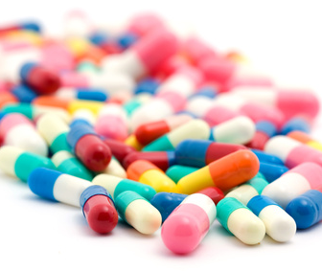
topical and oral treatment solutions
Topical and oral antibiotics
Birth control
Anti-androgens
Retinoids
Azaleic acid
Alternative therapies
Trends on the horizon
Notes:
As skin therapists, we would not be prescribing the medication, but it is important that we understand how it works and more importantly the side effects on the skin that we will more than likely be treating. Many medications can cause irritation, dryness, peeling and in some cases hyperpigmentation. Our clients will need our help to alleviate these side effects thus making their medical treatments more comfortable on their skin.
When medication is necessary
If infection with fluid pustules is present, oral and or topical antibiotics may be necessary and prescribed by a doctor, such as Grade 3 and 4 chronic inflammatory acne. Topical antibiotics tend to become ineffective in a matter of weeks as resistant strains of bacteria always develop. In addition, oral antibiotics and alternative treatments may be another choice or added into the treatment. Because acne-inducing bacteria are becoming more resistant to some popular antibiotics, alternative medications for the treatment of acne have gained increased interest in recent years. Of course this is doctor dependent on the appropriate prescription and approved combinations.
Link: First, let’s discuss some common medications prescribed for the treatment of acne.

Slide 38
Drug | Oral | Topical | Type of Acne | Mechanism | Side Effects
Antibiotics | Erythomycin, Minocycline, Tetracycline | Clindamycin, Erythomycin, Dapsone, Sodium Sulfacetamide | Moderate to severe | Target bacteria within the follicle; oral is usually prescribed with topical | Photosensitivity; red, dry, and itchy skin
Birth Control | Ortho Tri-Cyclen, YAZ, EstroStep |  | Mild to severe | Alter levels and activity of androgens (testosterone) | Acne may get worse before clearing; hyperpigmentation can develop
Retinoids | Isotretinoin, Acitretin, Alitretinoin | Tretinoin, Adapalene, Differin Gel, Tazorac, Renova | Moderate to severe | Oral targets sebaceous glands and topical increases cellular turnover | Photosensitivity; red, dry, and itchy skin
Anti-Androgen | Spironolactone |  | Moderate Hormonal Acne | Blocks hormonal activity on the sebaceous glands | Dizziness, nausea, headaches
Azelaic Acid |  | Aziderm, Azelex, Finacea | Mild to moderate | Keratolytic agent and anti-bacterial | Stinging or warmth; severe itching, redness or peeling
Notes:
Undergraduate Instructor: This chart gives us a brief overview of some common prescriptions used in the treatment of acne.
Antibiotics
Doxycycline, Erythomycin, Minocycline,Tetracycline are antibiotics that prevent the growth of bacteria that contribute to acne vulgaris. Oral antibiotics can reach the bacteria deep inside the skin and the follicles. Oral antibiotics are typically used for patients with moderate to severe acne symptoms. There are many different types of oral antibiotics that have been used to treat acne vulgaris. The efficacy of a particular antibiotic can vary significantly between individuals.
There a many different types of topical antibiotics to treat acne. The most commonly used topical antibiotics are Clindamycin (Cleocin) and Erythromycin (E-mycin). Topical antibiotics generally do not penetrate deeply into the skin and they are often ineffective (when used alone) against moderate to severe inflammatory acne.
A topical cream (5% dapsone) called Aczone approved by the US FDA can produce positive results for many acne sufferers. The antibacterial action of the medication is complemented by its anti-inflammatory activity. Treatment with dapsone can help reduce the scarring by reducing the amount of damage caused by activated white blood cells.
Sulfacetamide is an antibiotic and can limit the growth of bacteria that contribute to acne vulgaris. Sulfacetamide is rarely used alone as a treatment for acne usually used with an oral antibiotic or retinoid.
Birth Control
Oral contraceptives (The Pill) have been found to effectively clear acne in women either when used alone or in conjunction with an anti-androgen medication, such as spironolactone. Oral contraceptives approved by the US FDA for the treatment of hormonal acne contain ethinyl estradiol plus either the progestin norgestimate, norethindrone acetate or drospirenone. These oral contraceptives work together to alter levels and activity of hormones that can trigger acne.
Continued on next hidden slide.

Slide 39
Notes:
Retinoids
Oral Retinoids (active ingredient: Isotretinoin) are a powerful and controversial class of medication that can be extremely effective treatments for moderate to severe acne vulgaris, but can have some serious side effects and are not to be prescribed to pregnant women. Treatment with oral retinoids can improve acne symptoms by decreasing activity of the sebaceous glands. Slowing the growth of the sebaceous glands decreases the production of sebum, and in turn prevents the formation of clogged follicles and decreases the growth of P. acnes bacteria.
Topical retinoid medications have been shown to increase cellular turnover, which can help speed up the generation of new skin cells and reduce the appearance of minor blemishes. Topical retinoid medications that are routinely used as acne treatments: Tretinoin, Adapalene and Tazarotene.
Anti-Androgen
Spironolactone, a diuretic, is another known anti-androgen many dermatologists use off-label to treat acne, which works really well. It binds to the androgen receptor and therefore it inhibits the binding of DHT and testosterone. It also inhibits androgen biosynthesis and also inhibits 5-alpha reductase.
Azelaic Acid
Azelaic Acid is a small molecule that occurs naturally in certain types of plants, including rye, barley and wheat. Azelaic acid is the primary active ingredient in several topical acne treatments (Aziderm, Azelex, Finacea, Skinoren, etc.). In addition to being a mild keratolytic agent, Azelaic Acid also has some antibacterial properties. Azelaic Acid has been shown to be moderately effective for the treatment of mild to moderate acne and is less effective at resolving nodular, cystic acne. Pharmaceutical preparations usually come packaged at 15-20% creams.
Link: Let’s look at some alternative therapies.

Slide 40
how to recognize infectious skin diseases
Notes:
Sometimes you may encounter a skin disease which you may need to refer to a general practitioner for treatment, and may require prescription medication. There are many skin diseases and these are just a few of the most common that you should understand and be aware of.
Please remember that an infectious skin disease will need precaution to prevent the spread of infection, and referral to a doctor for diagnosis.

Slide 41
various forms
Bacterial
Viral
Parasitic
Fungal
Notes:
Infectious Disease – this slide is an overview of the different infectious disease categories that will be talked about.
Bacteria – is microscopic organisms that can reside in the body or invade the body. Some bacteria is actually beneficial to humans allowing us to digest specific types of foods or keep infections in check. It is when invading bacteria or foreign bacteria start to multiply and harm the body that a bacterial infection can occur. An infection could develop on any area of the body. Bacteria is generally found in the environment, on the skin, in the airways, in the mouth, in the vagina, and in the digestive tract. Bacteria can also enter the body through the skin, nose, eyes, vagina, or mouth.
Viruses – a virus is defined as any various number of submicroscopic parasites that can infect any animal, plant or bacteria. Often leading to a serious or even deadly disease. No virus can replicate without the help of a host cell. Most viruses are spread as they lack an ability to self-reproduce. Some of the most common or best known viruses include the common human cold, chicken pox, the herpes simplex virus, which causes cold sores, and the human immunodeficiency virus (HIV), which is the virus that causes AIDS.
Fungus – an organism of the kingdom Fungi lacking chlorophyll that feeds on organic matter. Fungi ranges from unicellular or multicellular organisms to spore-bearing syncytia. A Fungal infection is an inflammatory condition caused by a fungus.
Parasites – skin parasites (PAIR-uh-sites) are tiny organisms that invade the skin, often causing irritation and itching. Some parasites thrive on human blood and cannot live long without it.
Let’s learn a bit more about bacterial Infections and some of the common diseases professional skin therapists might see…

Slide 42
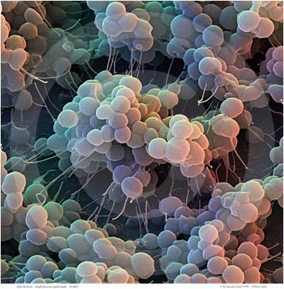
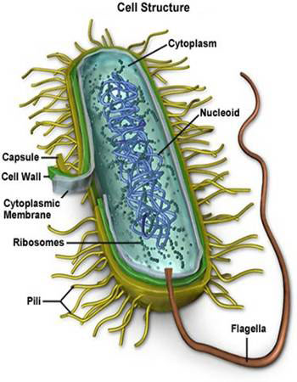
bacterial infections
Notes:
As a skin therapist, you need to be able to distinguish whether the infection is indeed an infection or just an injury to the skin. When you are in doubt, please refer the client to a doctor/dermatologist for further analysis. The skin is normally very resistant to a wide variety of bacteria. If the hydro-lipid film is intact, then the bacteria will find it difficult to reproduce as it is difficult for the bacteria to penetrate this protective layer. Most infections favor a moist environment, i.e. between the toes, around the mouth, nasal folds and the groin area. If you have the slightest doubt as to the nature of a skin infection – refer the client to a physician. This must be your unfailing rule.
Bacteria are often the cause of human disease. The skin provides a remarkably good barrier against bacterial infections. Although many bacteria live on the skin, they are normally unable to establish an infection. Bacterial skin infections may affect a single spot, appearing as a pimple, or may spread within hours, affecting a large area. Skin infections can range in seriousness from minor to life-threatening conditions.
Many types of bacteria can infect the skin. The most common are Staphylococcus and Streptococcus.
Link – We will be going through three particular skin infections caused by bacteria: Impetigo, Folliculitis and Conjunctivitis
42

Slide 43
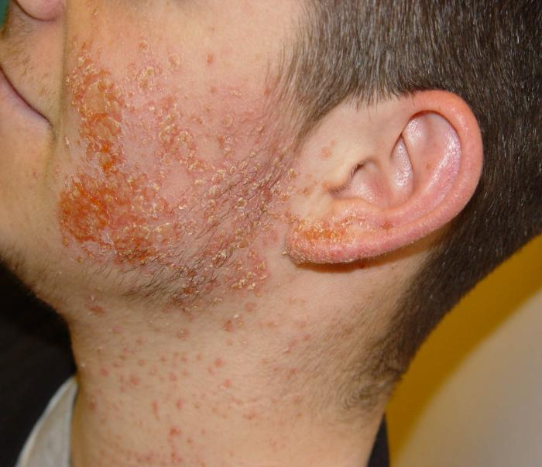
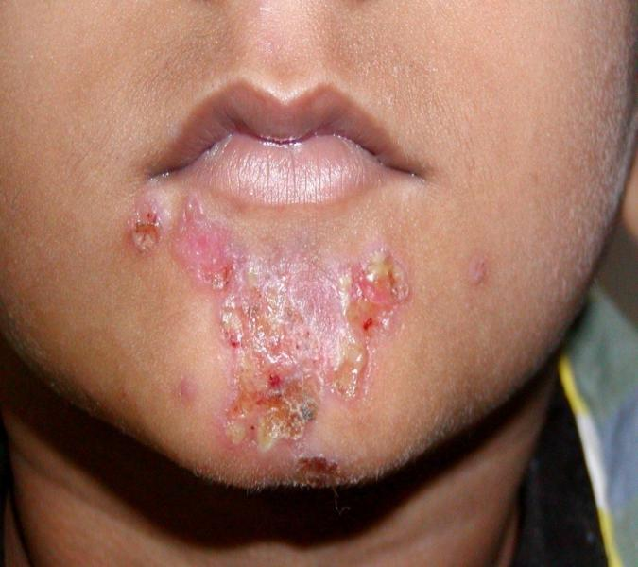
impetigo
Notes:
Impetigo – Highly contagious!
Description: Impetigo is a bacterial skin infection that occurs mainly around the mouth, nose and hands. Scratching can further spread infection. Impetigo is more common in children than it is in adults. This condition is HIGHLY contagious and can spread easily with direct contact of an infected person or by handling a contaminated object such as eating utensils, towels, toothbrushes, and bed linen.
Cause: Most commonly caused by staphylococci or streptococci bacteria.
Signs and Symptoms: Impetigo begins as a cluster of small blisters (vesicles) that expand and rupture within the first 24 hours. The thin yellow fluid that drains from the ruptured blisters, quickly dries forming a honey-colored crust, which breaks open and leaks fluid. These vesicles usually appear grouped closely together, and they may spread out and cover a large area of the skin. Impetigo infections most commonly occur during warmer weather.
What is the medical treatment for Impetigo? Impetigo may be treated with an oral or topical antibiotic. Common oral medications include: Ceftin, Altabax Top, mupirocin top, Cefuroxime axetil Oral. Other measures such as hygiene incorporating frequent hand washing, using antibacterial soap, isolating linens etc., may also be implemented.
How is this treated in the skin center? Please do not treat this client in a treatment room until the client has completed their course of antibiotics and the infection has cleared.
Link: The next bacterial infection is another very common infection affecting the eyes.

Slide 44
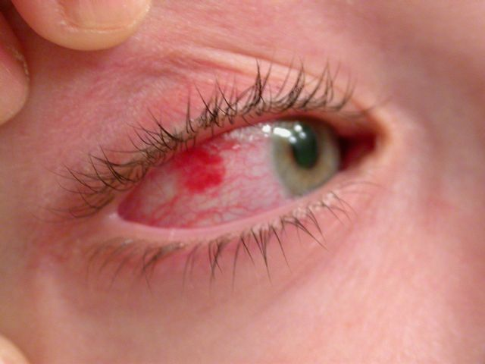
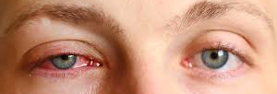
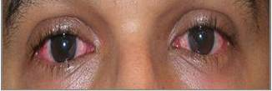
conjunctivitis (pink eye)
Notes:
Conjunctivitis – also known as Pink Eye
Contagious!
Description: Conjunctivitis is an inflammation of the conjunctiva, the clear mucous membrane that covers the white part of the eyeball and the inside of the eyelid. Inflammation of the blood vessels results in the redness and irritation. Usually affecting both eyes conjunctivitis (pink eye) may start in one eye and spread to the other after a day or two.
Cause: The cause of pink eye is commonly a bacterial or viral infection, an allergic reaction or – in babies – an incompletely opened tear duct. Viral conjunctivitis usually produces a watery discharge. Bacterial conjunctivitis often produces a thicker, yellow-green discharge. Both viral and bacterial conjunctivitis can be associated with colds or with symptoms of a respiratory infection, such as a sore throat.
Signs and Symptoms: Though inflammation of the eye can be irritating, it does not affect your vision. Symptoms may include increased tearing, a gritty feeling in the eyes, sensitivity to light, stickiness of the eyelids, swelling, yellowish discharge (or pus) and itching. Pink eye can be highly contagious for as long as two weeks after signs and symptoms begin.
What is the medical treatment for conjunctivitis? To determine what type of conjunctivitis or pink eye you have your doctor may examine your eyes and send a sample of eye secretions to the laboratory to determine which form of infection you have and how best to treat it. Most doctors will prescribe eye-drops or an ointment to apply.
How is this treated in the skin center? This a contagious infection. Treatment should not be given until two weeks after the infection has cleared.

Slide 45
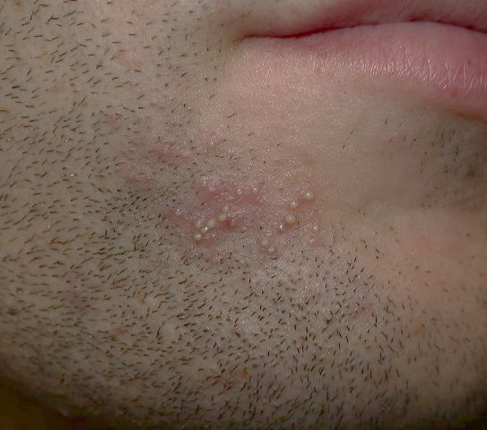
folliculitis
Notes:
Folliculitis – non-contagious and contagious forms
Description: Folliculitis is an inflammatory condition affecting the hair follicles. It appears as a small localized area of pus surrounding the opening of a hair follicle. Folliculitis can be found anywhere on the body bearing hair. This is mainly seen in the groin, axilla (underarms) or in the bearded area of men.
Cause: Folliculitis may be non-infectious which is the case of Pseudo folliculitis barbae, a very common ingrown hair condition on the beard area (lower face and neck) of men, or it may be caused by an infectious bacterium, fungus, or a virus. Staphylococcal Folliculitis is highly contagious. This condition which is caused by a bacterial infection, spreads by direct skin-to-skin contact. Sharing towels, razors, clothes or undergarments can also transmit the disease. Hot-tub Folliculitis is caused by the bacterium Pseudomonas aeruginosa and occurs after sitting in a hot tub that was not properly cleaned before use. Gram-negative Folliculitis may appear after prolonged acne treatment with antibiotics. A coexisting viral or fungal infection may also be present.
Signs and Symptoms: The most common sign is a pustular rash often resembling acne. Some people report itching or tenderness.
What is the medical treatment for folliculitis?
Depending on the cause and severity of folliculitis, it may require no treatment and resolve spontaneously, or it may require treatment with powerful antibiotics or other drugs. Mild cases are treated with antiseptic cleaner and antibiotic cream. More severe cases may require the addition of an oral antibiotic.
How is this treated in the skin center?
Depending on the severity, this could be a local contraindication or care can be used to ensure the area is cleansed properly helping to prevent and spread further infection. For mild cases, the use of salicylic or an exfoliation could be beneficial in helping to prevent ingrown hairs from occurring.
Link: Let’s take a look at some common viral infections.

Slide 46
viral infections
Notes:
This slide depicts a picture of a virus in our blood stream and a diagram of the Herpes Simplex virus on the right.
Viruses, unlike bacteria, need to be within a living organisms’ cells to reproduce. Viruses penetrate cell membranes so they can use the host cells’ own protein mechanism to replicate and assemble the virus structure.
We will be focusing our attention on two in particular: Herpes Simplex (fever blisters) and Warts
References:
ª ^{b} Norrby E (2008). "Nobel Prizes and the emerging virus concept". Arch. Virol. 153 (6): 1109–23. doi:10.1007/s00705-008-0088-8. PMID 18446425.

Slide 47
herpes simplex
Notes:
Herpes Simplex – Cold Sores
Extremely contagious!
Description: Herpes Simplex (cold sores) is a recurrent viral infection that affects the skin and mucus membranes. This virus has two types of infection: the classic cold sores on the lips and around the mouth; and genital cold sores, which are spread by sexual contact.
This common skin infection is also known as “fever blisters”. The first symptom is itchiness and tingling at the site of the developing infection, usually on the edge of the lips. Blisters soon appear and later burst to become crusted sores. The person usually feels unwell. The infection occurs only occasionally in some people, but frequently in others. Most people in the United States are infected with the causative virus by 20 years of age.
Origination of Herpes: It usually begins in childhood as a mouth infection. It is present in saliva of affected persons and can be spread in a family by the sharing of drinking and eating utensils and toothbrushes or by kissing. It is most important not to kiss an infant if you have an active cold sore.
The virus then lives in the nerves supplying the skin or eyes, waiting for an opportunity to become active. It may erupt on any area of the body or in the eyes.
What is the medical treatment? No known cure is available. Most sores heal and clear within 7-10 days. An Antiviral may be used to shorten the duration by a day or two.
How can it be prevented? Those prone to cold sores should avoid overexposure to sun and wind. If you cannot, apply a sunscreen or zinc oxide ointment around the lips and other areas where cold sores have erupted previously. The following may cause eruptions: overexposure to sunlight, overexposure to wind, colds, influenza and similar infections, heavy alcohol use, fever from any cause, the menstrual period, physical stress or emotional stress.
How is this treated in the skin center? As this is a contagious infection, we would not treat the individual until the viral infection has dissipated. If someone is prone to outbreaks, it is important to inform them that certain treatments (laser, waxing, chemical peels) may cause an outbreak.
Link: Another viral infection we need to be familiar with are warts.

Slide 48
warts
Notes:
Warts (Verruca)
Contagious
Description: Warts are non-cancerous skin growths caused by a viral infection in the top layer of the skin. Warts are usually skin-colored and feel rough to the touch, but they can be dark, flat and smooth. The appearance of a wart depends on where it is growing. Most are located on the hands (common warts), feet (plantar warts), face (flat warts) and genitals (genital warts).
How do you get Warts? Warts are caused by several strands of the human papilloma virus (HPV). Warts are contagious and are spread by direct contact or by skin shed from the lesion.
Signs and symptoms:
Most warts are rough, raised, and round or oval-shaped masses that can either be lighter or darker in color. Some refer to them as looking like cauliflower. In most cases warts will cause little to no discomfort unless they are in an area of repeated pressure. Warts contain small clotted blood vessels that resemble small black seeds (called wart seeds).
How are Warts treated? Most warts can be treated with an over the counter product containing salicylic acid. Persistent warts require medical attention such as freezing (liquid nitrogen), laser treatment or surgical. Warts tend to reoccur after treatment.
How is this treated in the skin center? Local contraindication is needed until the area has healed. Linens should be treated as contaminated.
Link: The next infection is fungal infections.

Slide 49
fungal infections
Notes:
Picture shows: The Trichophyton fungus, photographed under an electron microscope at more than 4,000 times its original size, causes ringworm of the scalp (tinea capitis).
Fungi do not belong to either the plant or animal kingdom but have a kingdom of their own obtaining their nutrition from the decomposition of organic matter.
The English word fungus is directly adopted from the Latin fungus, meaning "mushroom", which is in turn derived from the Greek word sphongos ("sponge"), referring to the macroscopic structures and morphology of some mushrooms and molds.
Link: Let’s explore two different fungal infections – Tinea Versicolor and Ringworm including Athlete’s Foot.

Slide 50
tinea versicolor
Notes:
Tinea Versicolor-
Not contagious
Description: Tinea Versicolor is a common skin condition due to an overgrowth of a skin surface yeast. This overgrowth results in uneven skin color and scaling that can be unsightly and sometimes itch. The yeast normally lives in the pores of the skin and thrives in oily areas such as the neck, upper chest, and back. Tinea Versicolor has small, scaly white-to-pink or tan-to-dark spots which can be scattered over the upper arms, chest and back. They may sometimes appear on the neck and the face. On light skin, Tinea Versicolor may be faint or can appear as tan-to-pink spots, while on dark skin Tinea Versicolor may be light or dark.
Cause: Tinea Versicolor is caused by the yeast Malassezia furfur or Pityrosporum orbiculare. This yeast is normally found on the human skin and only becomes troublesome under certain circumstances, such as a warm and humid environment. The fungus grows slowly and prevents the skin from tanning normally. As the rest of the skin tanning in the sun, the pale spots, which are affected by the yeast, become more noticeable, especially on dark skin.
Signs and Symptoms: Factors that can cause the fungus to become more visible include high humidity and immune or hormone abnormalities. However, almost all people with this very common condition are perfectly healthy. In countries with continuous high heat and high humidity, people can have these spots year round. In other climates, the spots generally fade in the cooler and drier months of the year.
Treatment: Tinea Versicolor may be treated with topical or oral medications. However with treatment Tinea Versicolor may still recur. After any form of treatment, the uneven color of the skin may remain several months after the yeast has been eliminated until the skin repigments normally.
How is this treated in the skin center? We would not treat the condition itself but can treat the skin for the dehydration, etc the client may be suffering from.
Link: A fungal infection that is probably quite familiar to us is Ringworm or a common form – Athlete’s Foot…

Slide 51
ringworm
Notes:
Ringworm
Contagious!
Description: Ringworm is a contagious fungal infection that can affect the scalp, body, feet (Athlete's Foot), or the nails. Ringworm is caused by several different fungus organisms that all belong to a group called “Dermatophytes”.
Cause: Ringworm is spread by either direct or indirect contact. People can get Ringworm by direct skin-to-skin contact with an infected person or pet. People can also get Ringworm indirectly by contact with objects or surfaces that an infected person or pet has touched, such as hats, combs, brushes, bed linens, stuffed animals, telephones, gym mats, and shower stalls. In rare cases Ringworm can be spread by contact with soil.
Ringworm of the skin will usually appear 4-10 days after contact vs. the scalp which could take as long as 10-14 days. Please note that Ringworm is contagious even before symptoms have appeared.
What is the treatment for Ringworm? Ringworm can be treated with fungus-killing medicine. The medication can be taken in tablet or liquid form orally or as a cream applied directly to the affected area. Steps to prevent infection include: keep common-use areas clean, especially in schools, day-care centers, gyms, and locker rooms and your treatment center. Disinfect sleeping mats and gym mats after each use along with towels and sponges or equipment you may use in your treatment. Do not share clothing, towels, hair brushes, or other personal items. Infected clients should follow these steps to keep the infection from spreading: complete treatment as instructed, even after symptoms disappear.
How is this treated in the skin center? It cannot be treated in the treatment center as once again this is a contagious infection. Again, avoid the client’s skin (feet, scalp, etc) until they have completed their course of medication and all traces of the infection have dissipated.
Link: Let’s learn a bit about parasitic infections…

Slide 52
parasitic infections
lice
scabies
Notes:
In general, parasitic infections are organisms that live inside humans or other organisms who act as hosts. They are dependent on their hosts because they are unable to produce food or energy for themselves. Parasites are harmful to humans because they consume needed food, eat away body tissues and cells, and eliminate toxic waste, which makes people sick. Some parasites are known to live outside of humans such as ticks, mites, fleas, lice, and bedbugs may cause intense itching in affected areas. Skin parasites are found worldwide and infest large numbers of people. For example, as many as 6 to 12 million people worldwide contract head lice every year, according to the U.S. Centers for Disease Control and Prevention. Head lice most often affect children in school and daycare settings.
Lice
Contagious
Description: Louse (singular for lice) is a wingless parasite that lives its entire life cycle on a human host depending on its blood for survival. Three forms of lice are known; head lice, body lice, and pubic lice (crabs). Lice is highly contagious and acquired by close physical contact with an infected person and through contaminated items such as towels, combs, brushes, pillowcases, and hats. The female will produce approximately every 2 weeks, preferring to lay eggs on hair shafts close to the scalp but may lay eggs in folds of clothes
Cause: Infestations are caused by one of three species of lice; head louse (pediculus humanus capitis), body louse (P.humanus corporis) and pubic louse (Phthirus pubis).
Signs and Symptoms: The most common sign of head lice is the presence of nits (egg sacs) on hair shaft on the body or in clothing. They appear like oval, yellowish pinpoint specks.
What is the treatment for Lice? Treatment involves removing lice and killing their eggs. Over the counter treatments and prescription medications are available. In most instances all family members and those that are in close contact with the infected will need to be treated.
How is this treated in the skin center? Treatment is not to be performed until the condition has been treated.
Scabies
Contagious
Description: Scabies is a skin infection caused by burrowing parasitic mites. The areas most affected are between the fingers, creases of the wrists, elbows, knees, waistline, axillae (underarms) under breasts and lower buttocks.
Cause: Scabies infestations are caused by a mite called Sarcoptes Scabiei.
Signs and symptoms: The most common sign is a skin rash of thin, tiny, light brown lines often referred to as a scabies trail. Most times you will see tiny blisters or reddened skin where one has itched. These lines are burrows used and created by the female mites to deposit their eggs. Bites are usually time of feeding cycle. Most people are not even aware of the intruders until intense itching begins 2 to 6 weeks later.
What is the treatment for Scabies? Prescription ointments is the most common way to eliminate the scabies infestation. In most instances all family members and those that are in close contact with the infected will need to be treated.
How is this treated in the skin center? Treatment is not to be performed until the condition has been treated.

